Slide 1

The Algorithms Invented by a Cohort of 4th Class Children for the Solution of Multi-Digit Multiplication Tasks
Presented by Jean Donnelly
Maths4All TeachMeet 2020

Slide 2

Presentation Layout
Background to the study
How the study worked in my classroom
An overview of the development of multi-digit multiplication strategies
Discussion of the children’s invented algorithms
Recommendations for the classroom

Slide 3
Background to the Study
Rationale for the Study
Context of the Study
Goal of the Study
A substantial body of research, outside of Ireland, on children’s invented algorithms has shown that children are capable of inventing algorithms to solve various types multi-digit multiplication tasks. However, this has not been well documented in the literature in the Irish context.
This study was carried out with my own class in a large multi-cultural school. The 4th class group comprised of twenty eight children. Traditionally, children were given few opportunities to explore their own ideas and understanding of the “long multiplication” algorithm.
My goal in this study was to ascertain what strategies the cohort of 4th class children could invent for multi-digit multiplication when working collaboratively to solve a set of real life tasks.

Slide 4
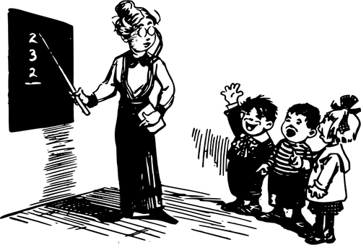
How the study worked in my classroom
The pupils engaged in six tasks whereby they worked collaboratively in groups of three or four to solve tasks that involved multi-digit multiplication. However, the pupils were not introduced to the standard multiplication algorithm prior to their engagement in the action research
tasks. Whole-class discussions featured at the beginning and end of each session when solutions and invented strategies were shared and considered by others. Groups logged their thoughts on the ideas presented by others in their mathematics journal.

Slide 5
An Overview of the Development of Multidigit Multiplication Strategies
During the course of the action research, most pupils developed sophisticated strategies as the tasks progressed. The strategies used by each group varied with their knowledge of addition, units, grouping by tens, place value and properties of the four basic operations. Pupils predominately used repeated addition at the beginning of the cycle. Most groups then made a clear progression from repeated addition strategies to developing more sophisticated partitioning number strategies, which ultimately, closely paralleled the conventional long multiplication algorithm.

Slide 6
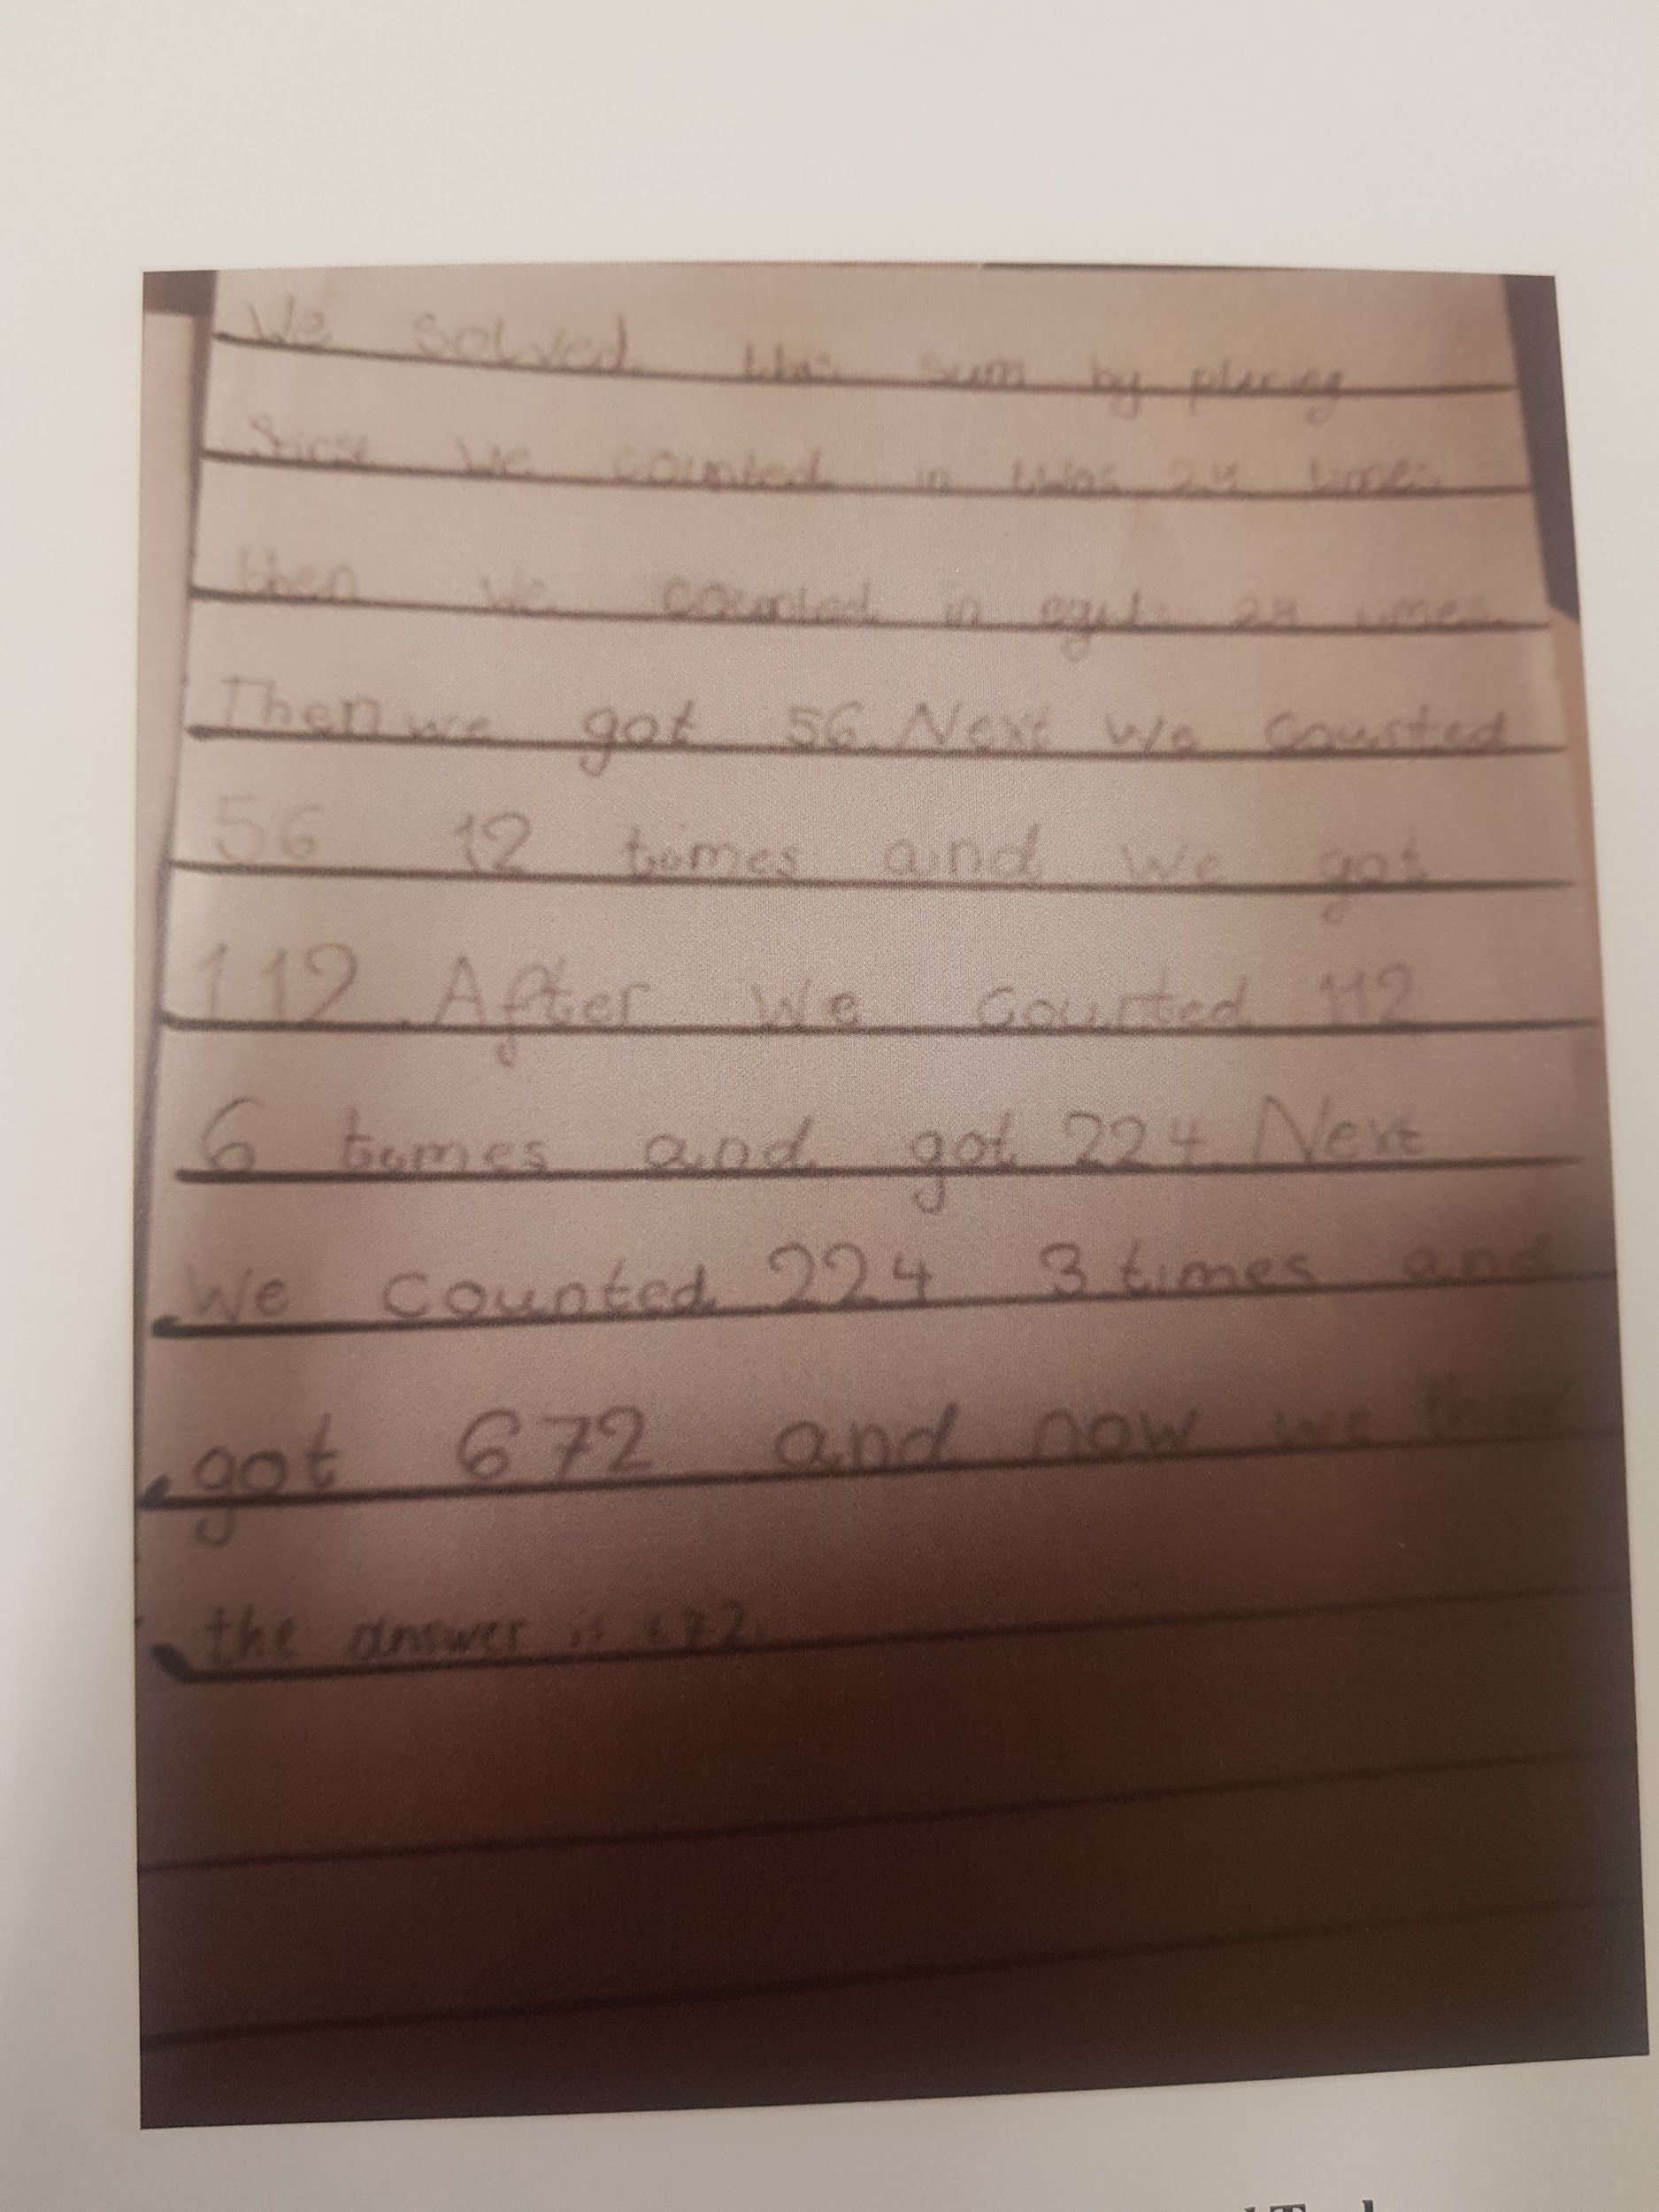
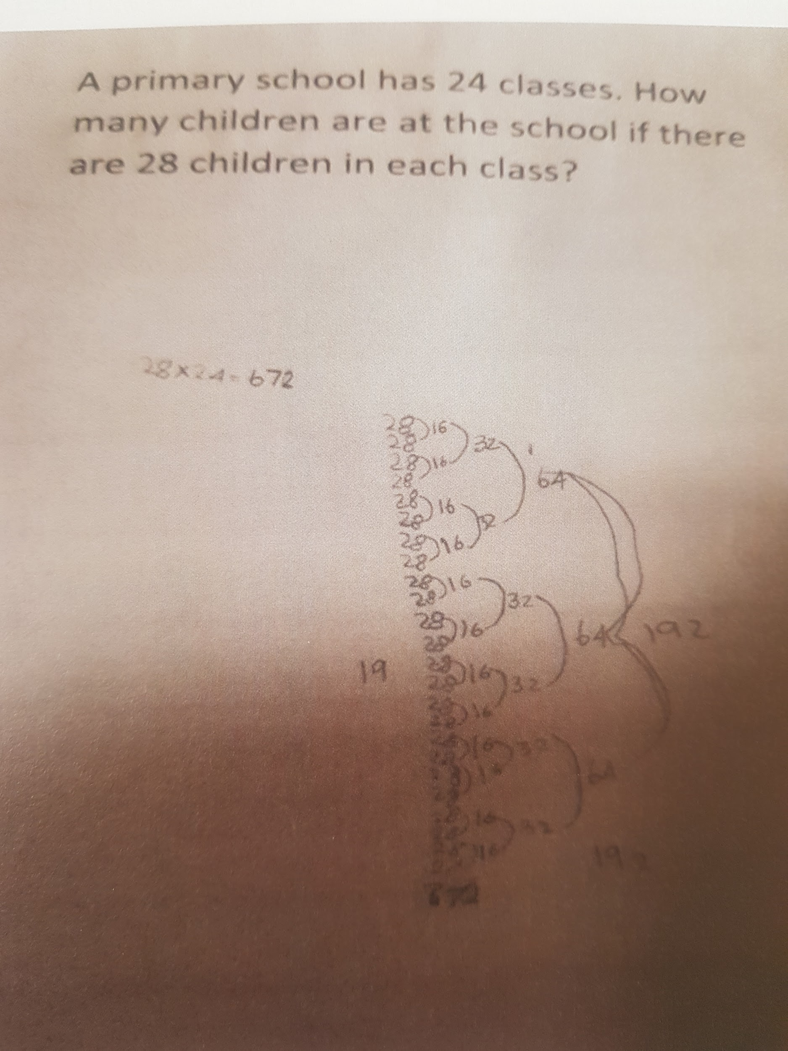
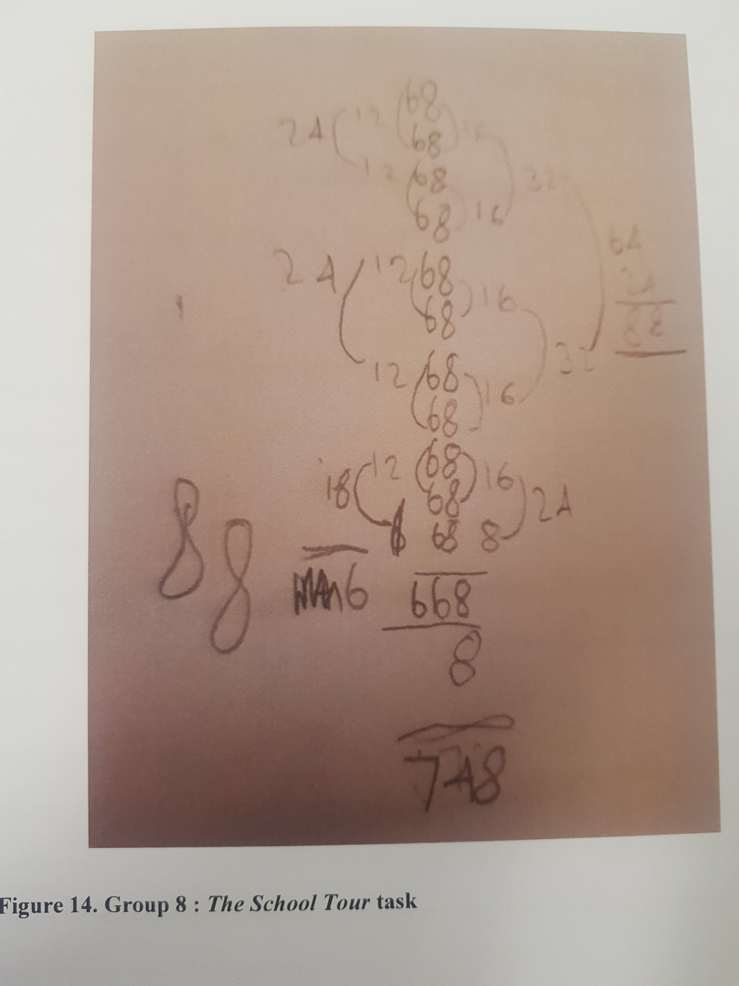
Invented Algorithms

Slide 7
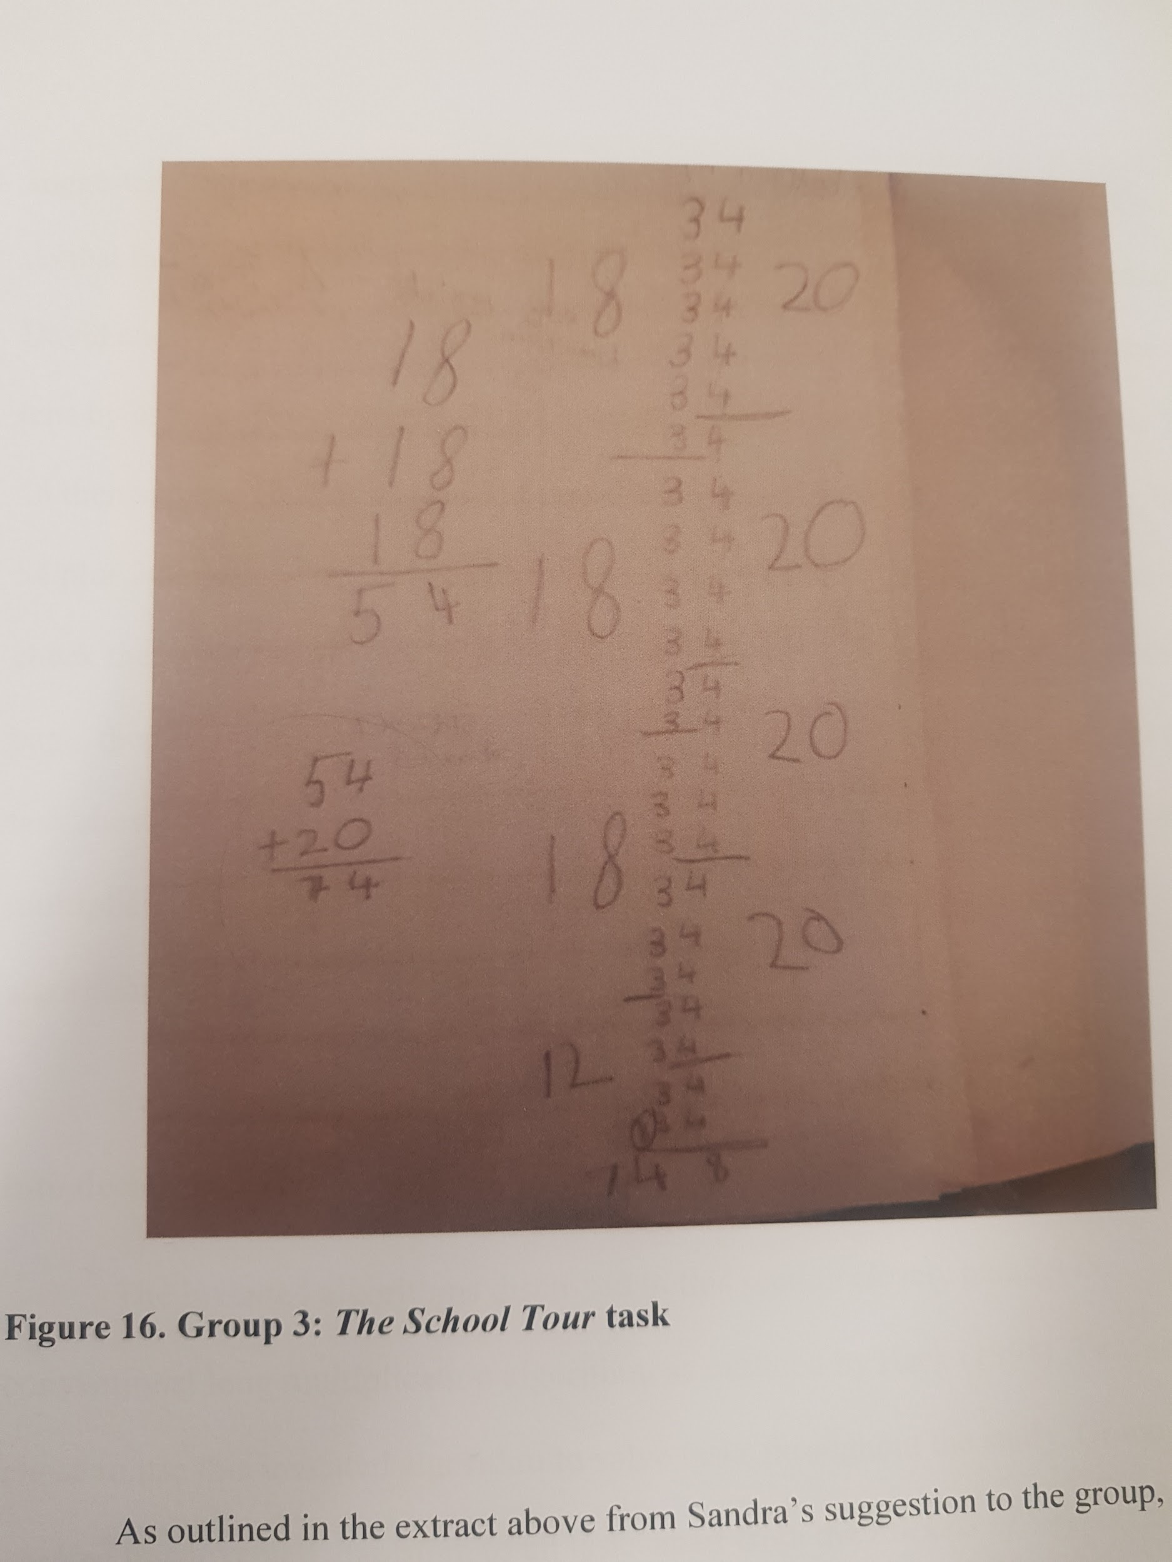
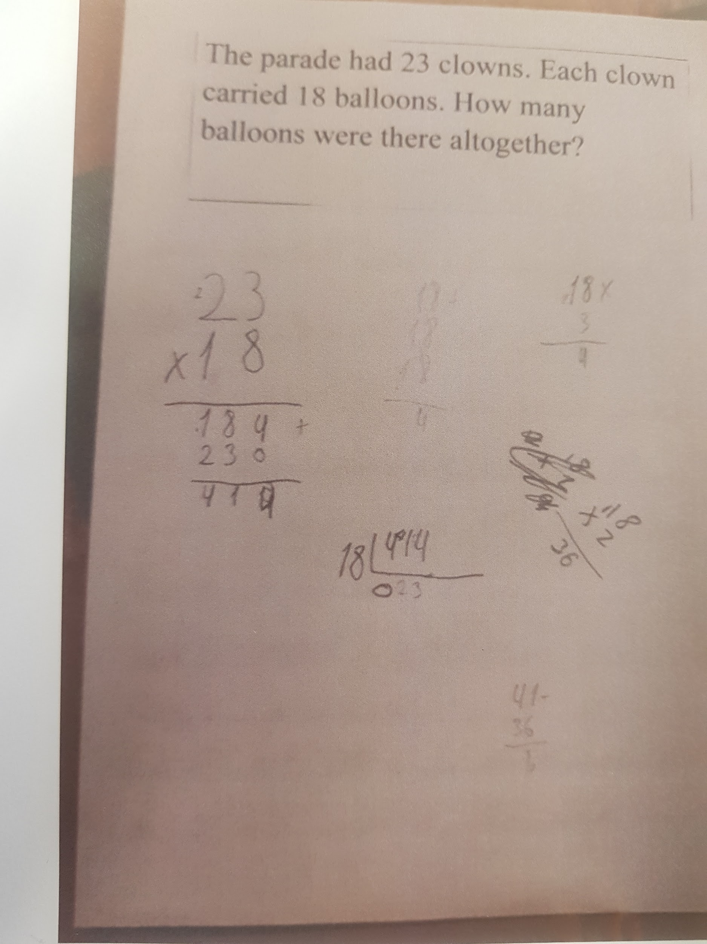
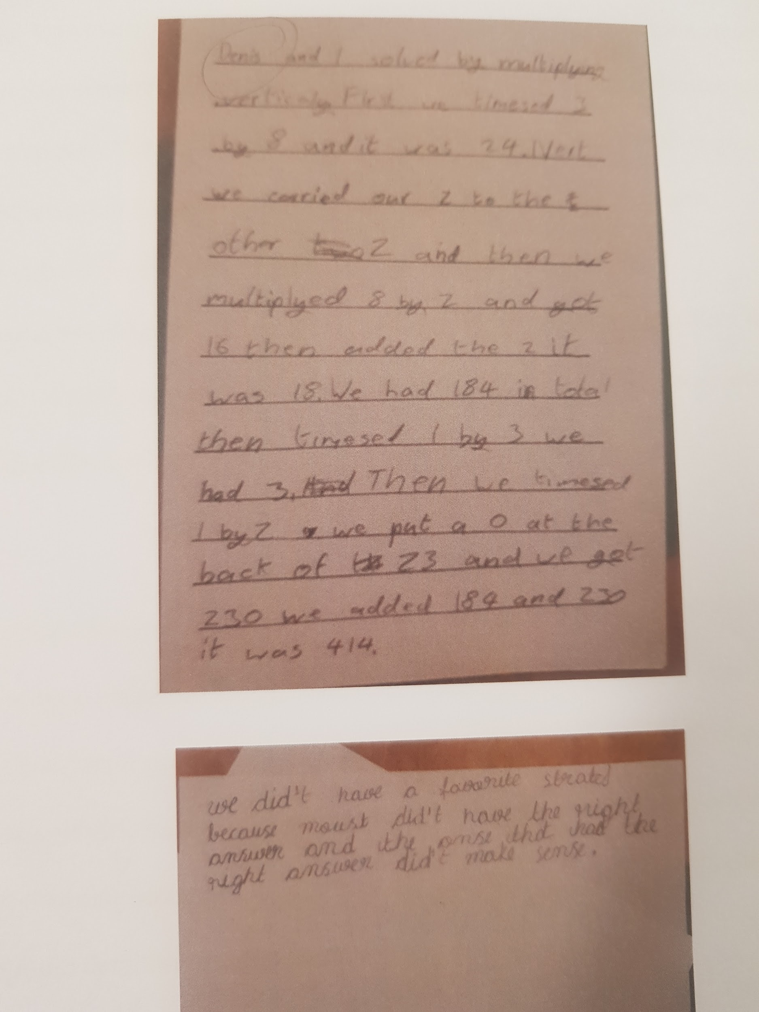
Invented Algorithms

Slide 8
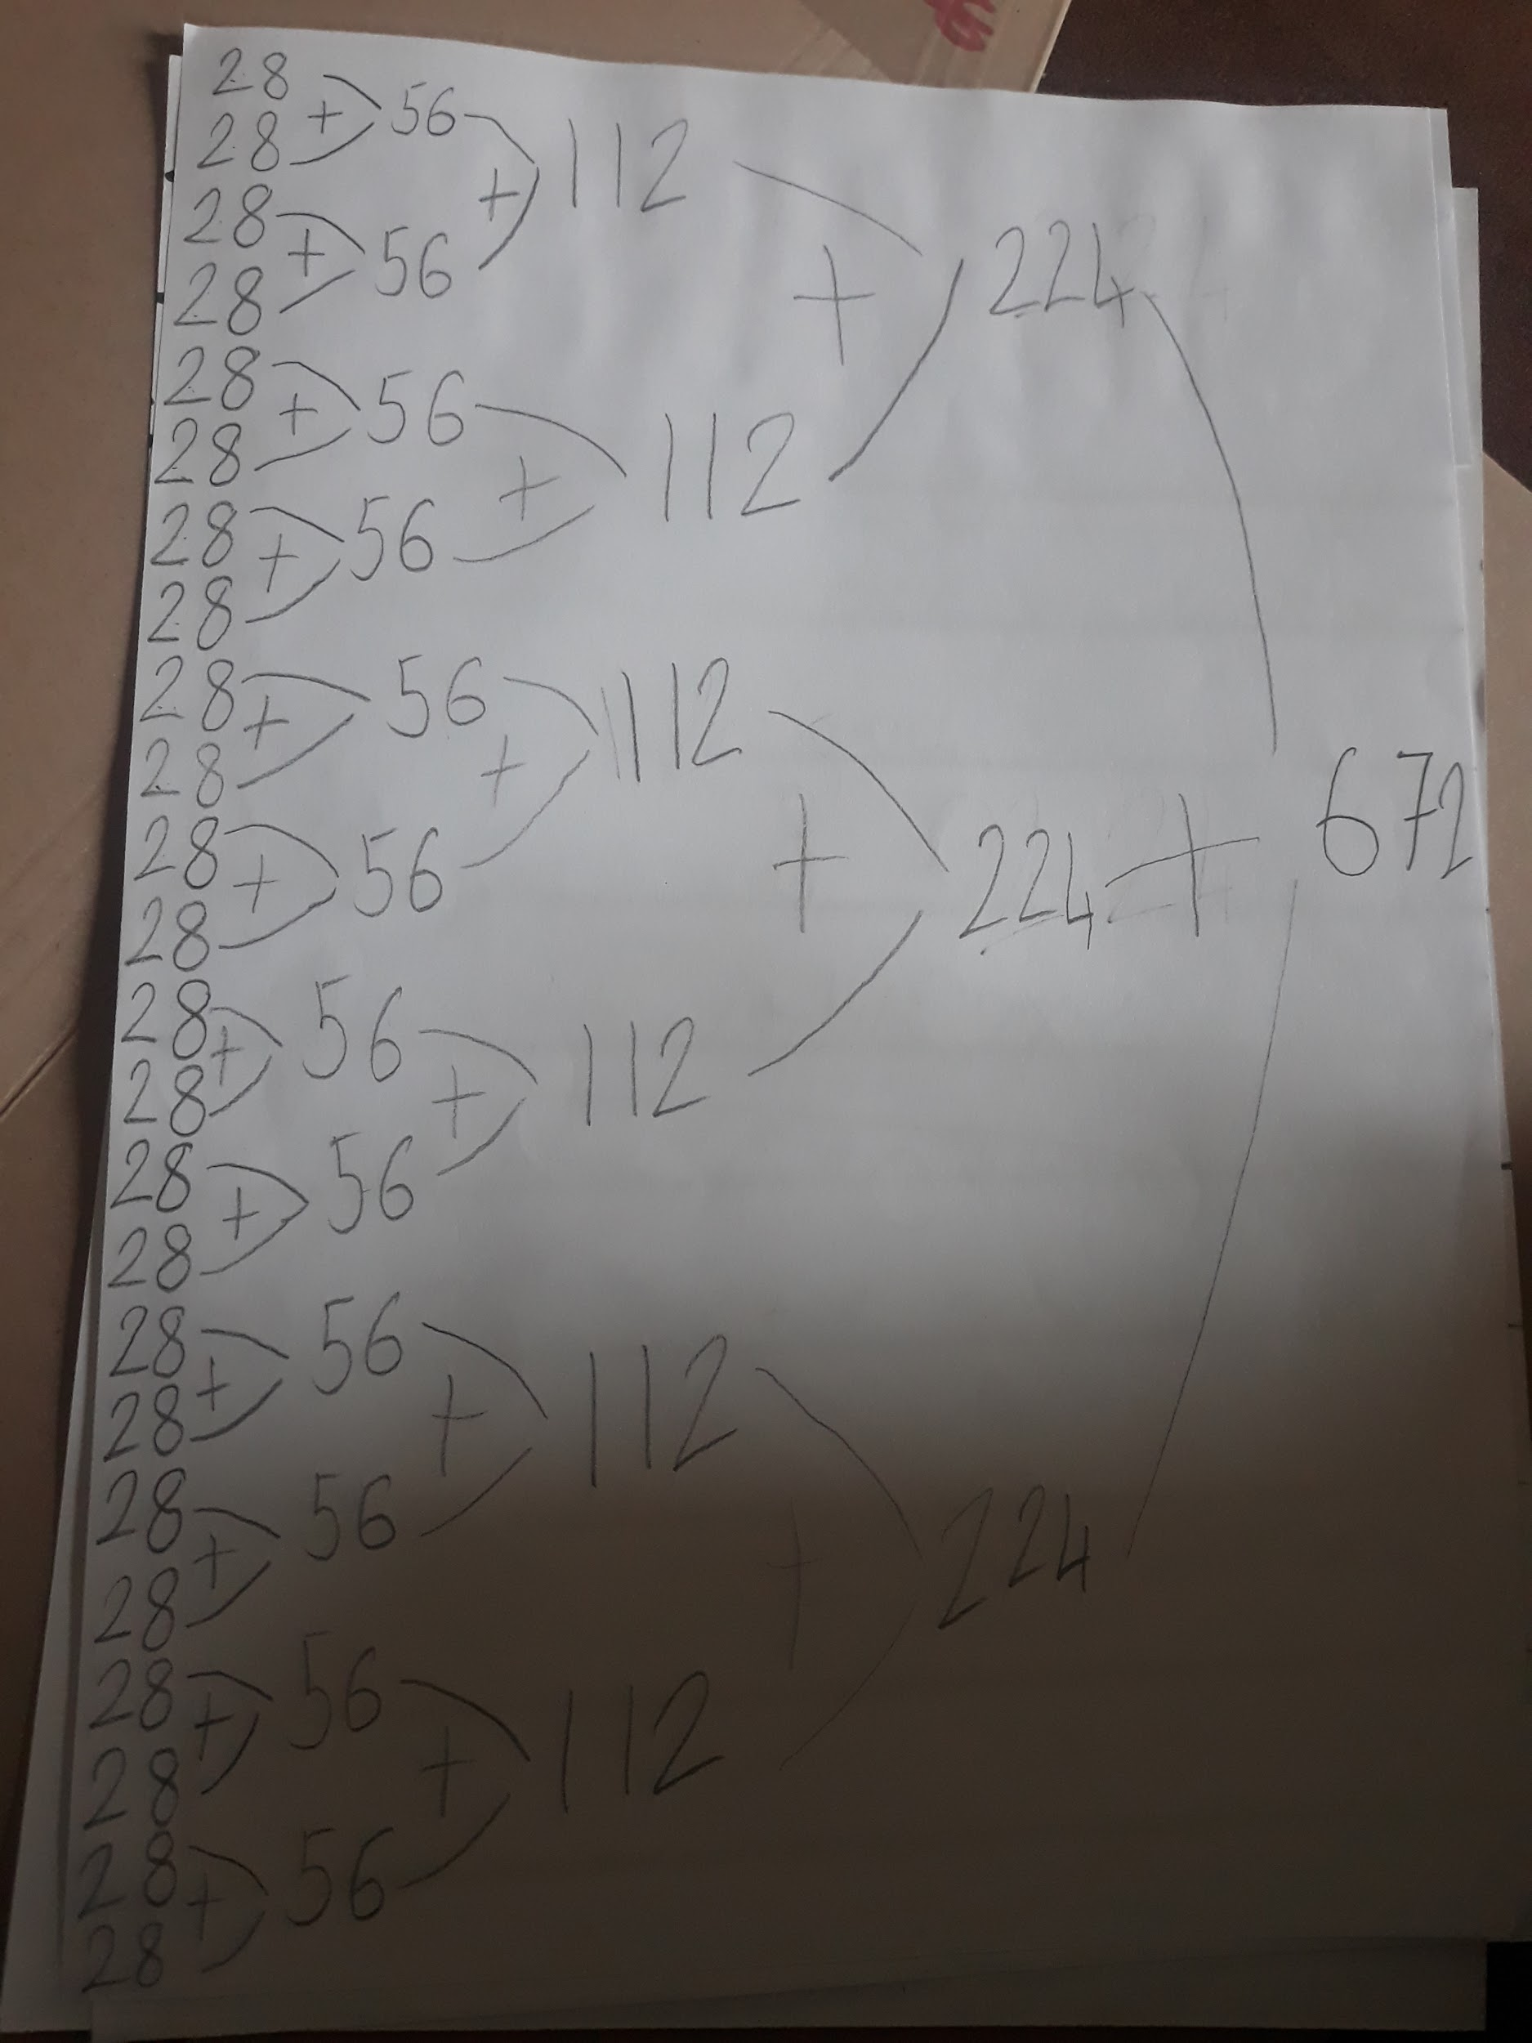
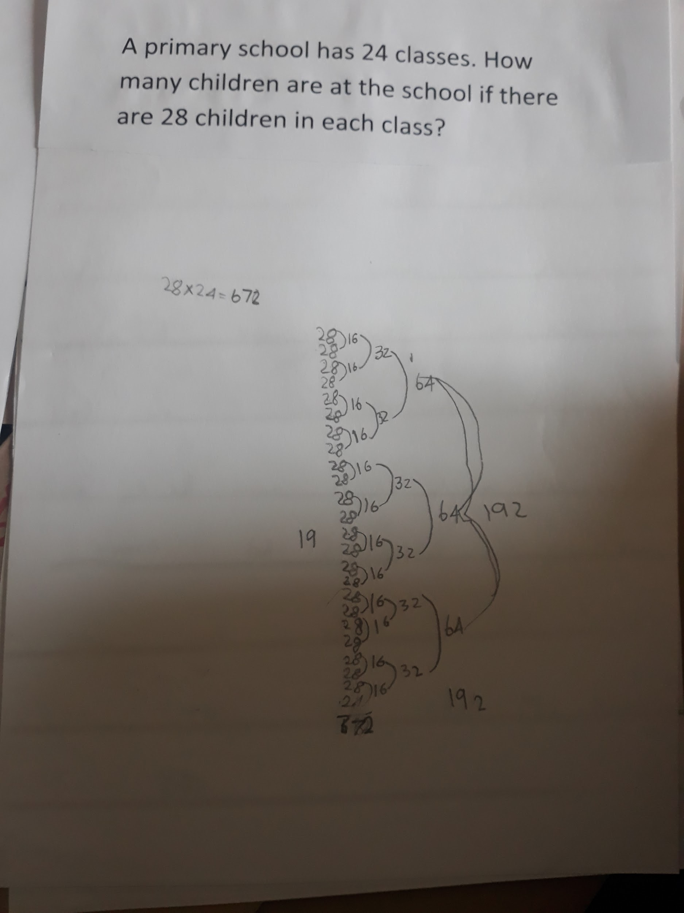
Invented Algorithms

Slide 9
Conclusions and Recommendations
Children can and do invent algorithms for multi-digit multiplication when given the opportunity to do so. Furthermore, the algorithms children invent provide us with a window into how they think about the additive or multiplicative composition of numbers in solving multiplication tasks.
The importance of: “doing mathematics” - “mathematization”, maths talk, collaborative learning and developing growth mindsets.
Thank you.

