Slide 1
Using Picture Books in the Mathematics Classroom
Edward Fitzgerald

Slide 2
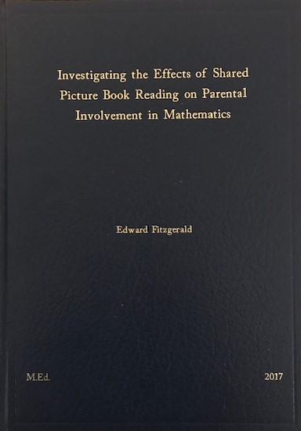
Interest in Picture Books
Thesis
Main Findings
Parents had a negative attitude to maths – own experiences of maths in school
Parents wanted to become more involved
Parents and children enjoyed the intervention
The potential of using picture pictures in the mathematics classroom

Slide 3
Benefits of using Picture Books
Increased motivation (Hong, 1996; Von Drasek, 2006) – ‘‘Harry now says maths is his favourite subject whereas before he had no real interest’’
Contextualised based problem solving (van den Heuvel-Panhuizen & Elia, 2012) - ‘‘ thought the picture books made it more fun and relatable’’
Development of mathematical discussions (Anderson & Anderson, 1995) - ‘‘amazing to witness the interaction and mathematical discussions that arise from picture books’’
Notes:
Research shows that there are many benefits to using picture books in mathematical lessons. Firstly, research has shown that picture books can be used to deepen children’s understanding of mathematical concepts. Picture books can also increase children’s motivation to engage in mathematics while at the same time deepening children’s appreciation of mathematics. Picture books can also allow contextualised based problem solving to take place which can make learning more meaningful for the children. Finally, picture books allow for the development of rich mathematical discussions to take place.

Slide 4
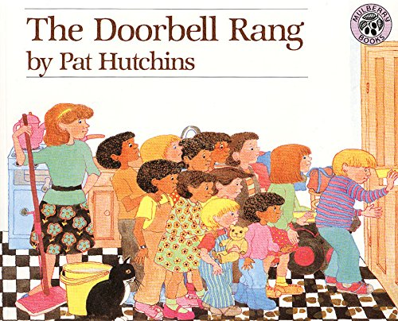
The Doorbell Rang
Mathematical Topic: Division, sharing
Class Level: 1St – 3rd class
Lesson Idea: Investigating the division of cookies to a number of people
Notes:
After the pre intervention interviews I then invited parents into the classroom to observe a lesson in which I read a picture book, a wonderful book called The Doorbell Rang by Pat Hutchins, to the class. The purpose of this exercise was to give parents a better understanding into how a picture book could be used to stimulate mathematical discussions. The parents had the opportunity to observe the types of questions they could ask their children during the intervention. Overall, the feedback from the parents was positive, with many indicating that they were excited and looking forward to be more involved with their child’s mathematics learning at home.

Slide 5
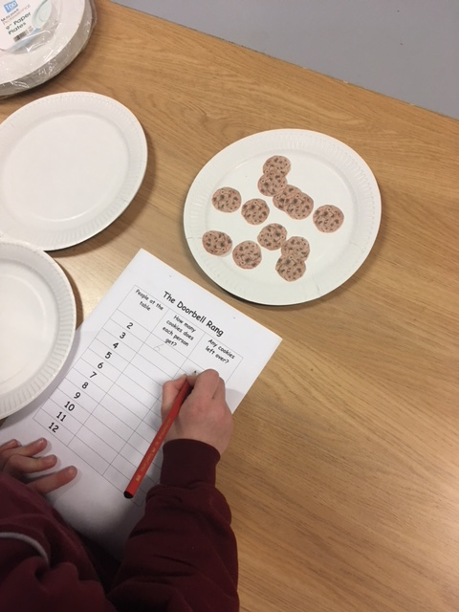
Problem Solving
Children are given worksheet, paper plates and cookie cut outs
They work out how many cookies each person gets if there was 2, 3,4, 5 etc. people at the table

Slide 6
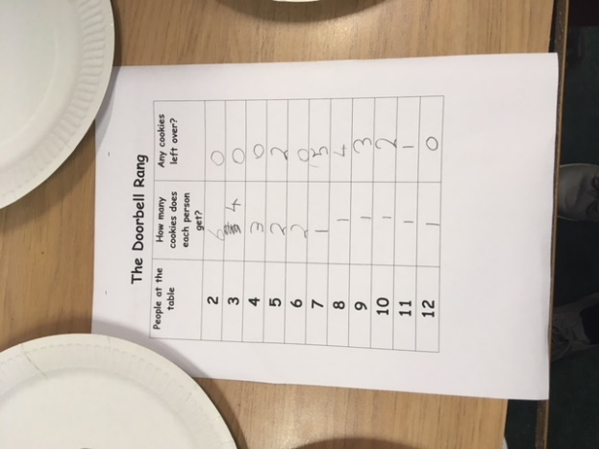
Problem Solving
Children discuss if they can observe any patterns emerging in the results table – as the number of people increase, the number of cookies decrease.
Children discuss what they would do with any left over cookies - linkage to fractions and remainders

Slide 7
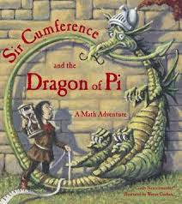
Sir Cumference and the Dragon of Pi
Mathematical Topic: 2D shapes, The Circle
Class Level: 5th and 6th class
Lesson Idea: Investigating the relationship between the diameter and the circumference of a circle
Notes:
After the pre intervention interviews I then invited parents into the classroom to observe a lesson in which I read a picture book, a wonderful book called The Doorbell Rang by Pat Hutchins, to the class. The purpose of this exercise was to give parents a better understanding into how a picture book could be used to stimulate mathematical discussions. The parents had the opportunity to observe the types of questions they could ask their children during the intervention. Overall, the feedback from the parents was positive, with many indicating that they were excited and looking forward to be more involved with their child’s mathematics learning at home.

Slide 8
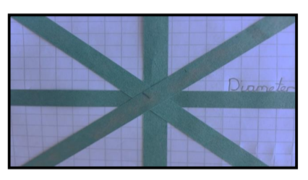
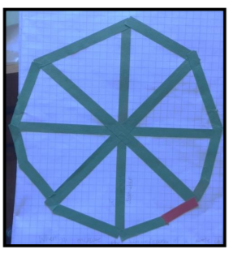
Problem Solving
The children worked in groups using strips of paper to mark out the spokes of the wheel (strips need to be same length)
They then used strips of paper to join the ends of each spoke (they used strips which were the same length of the diameter)

Slide 9

Problem Solving
It was noted that the children needed 3 and a ‘bit’ strips of paper to complete the circumference of the circle.
Discussion based on what fraction of a strip of paper was the ‘bit’.
Between 1/8 and 1/6.
Dividing the circumference by the diameter.

Slide 10
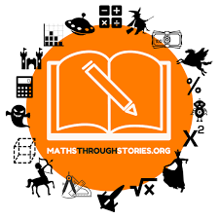
Maths Through Stories

Slide 11

Thank you for listening

