Slide 1
Simply Does It!
Nursery Rhymes and Math in the Early Years
Caroline Purvis 15/10/2020

Slide 2
Rationale – Why Nursery Rhymes
Changes to ECCE Scheme children now commencing pre-school at 2 yrs 8 months
Teachers may not understand the importance of Nursery Rhymes in introducing math concepts in a fun and playful manner.
Babies and children are born with a mathematical mind which must be nurtured and scaffolded to ensure that children are accepting of it at a later stage.
Allows for holistic development across the development trajectory.
Supportive measure for children with EAL.
Social and Group Activity – Fun!

Slide 3
There is more to Math than numbers !
Nursery Rhymes which explore phonics and phonology may help children to develop better maths skills (Nursery World, 2019). Intelligence and working memory is needed for all activities.
The Language of Math is of particular importance. Learning is holistic and does not happen in Isolation.
Regular use of words such as many, most, few, full, empty, first, second, last, up, down, left, right etc. and opportunities to experience these in a concrete form.
Simple and effective way for parents to work in partnership with teachers in understanding and supporting children in developing math skills.
Nursery Rhymes can promote interest and knowledge of shapes, numbers, measurement, pattern and problem solving within the prepared environment.
“Mathematic education should address the range of mathematical ideas that all children need to engage with. It should not be limited to number” (NCCA,)

Slide 4
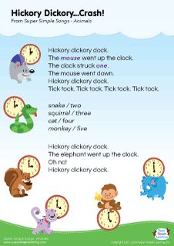

Slide 5
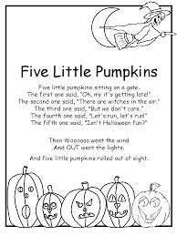
Baa Baa Black Sheep
Baa, baa, black sheep, Have you any wool? “Yes sir, yes sir, Three bags full!” One for the Master, And one for the Dame, And one for the little boy, Who lives down the lane.
Twinkle, Twinkle Little Star
Twinkle, twinkle, little star, How I wonder what you are. Up above the world so high, Like a diamond in the sky. Twinkle, twinkle, little star, How I wonder what you are.

Slide 6
Conclusion
It is important to understand and meet the child where they are in their development.
Early Years Teachers should understand what they are trying to achieve, and how this can be facilitated in an individual classroom.
Children can be enabled to explore concepts introduced in Nursery Rhymes through play and exploration within the prepared environment.
Teachers and parents have an important role in scaffolding the child’s learning.
It’s all about the delivery! Rhyme time should be fun, children should be active participants.
Repetition, Repetition, Repetition!
Do not underestimate the importance of the foundations for later learning.

Slide 7
Useful Resources/References
National Council for Curriculum Assessment (2014) Mathematics in Early Childhood and Primary Education (3-8 years). Dublin
Teachearlyyears.com
Twinkl.ie
Zero to Three ‘Help Your Child Develop Early Math Skills’ available @https://www.zerotothree.org/resources/299-help-your-child-develop-early-math-skills (accessed 10/10/2020)

