Slide 1
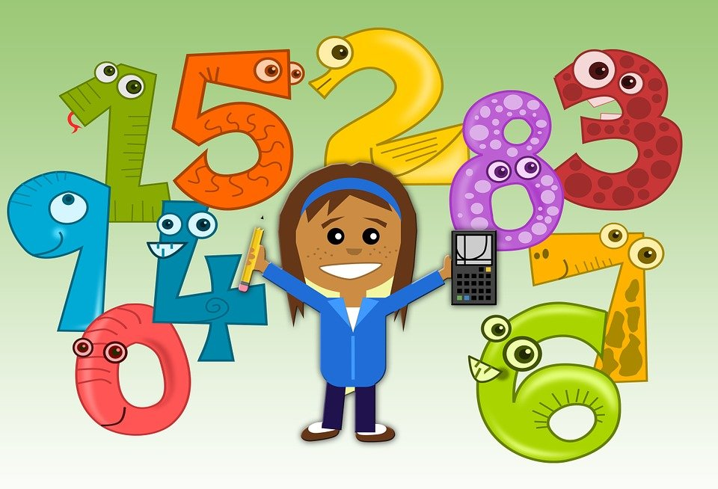
Early Numeracy Through Play and Every day Learning Experiences
BY ANGELA FÖLDES
CARR’S CHILD AND FAMILY SERVICES

Slide 2

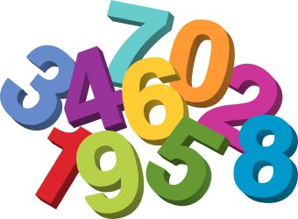
Numeracy and Play
Early Numeracy :
  basic maths concept: identifying numbers, counting, noticing patterns & sequencing, time, measuring, sorting, using positional directional language, etc.
  everyday interactions
  through play
Play:
natural language of the child
Charles E. Schaefer (2014)
makes learning an enjoyable experience
initiates learning
facilitates learning
strengthen the individual
hands on experiences

Slide 3

Implementing Early Numeracy Learning Experiences through Play in Carr’s Child and Family Services
Environment:
Indoor environment
Outdoor environment
Hands on experiences:
Child led learning experiences
Free choices
Plenty of materials
Parental Involvement

Slide 4

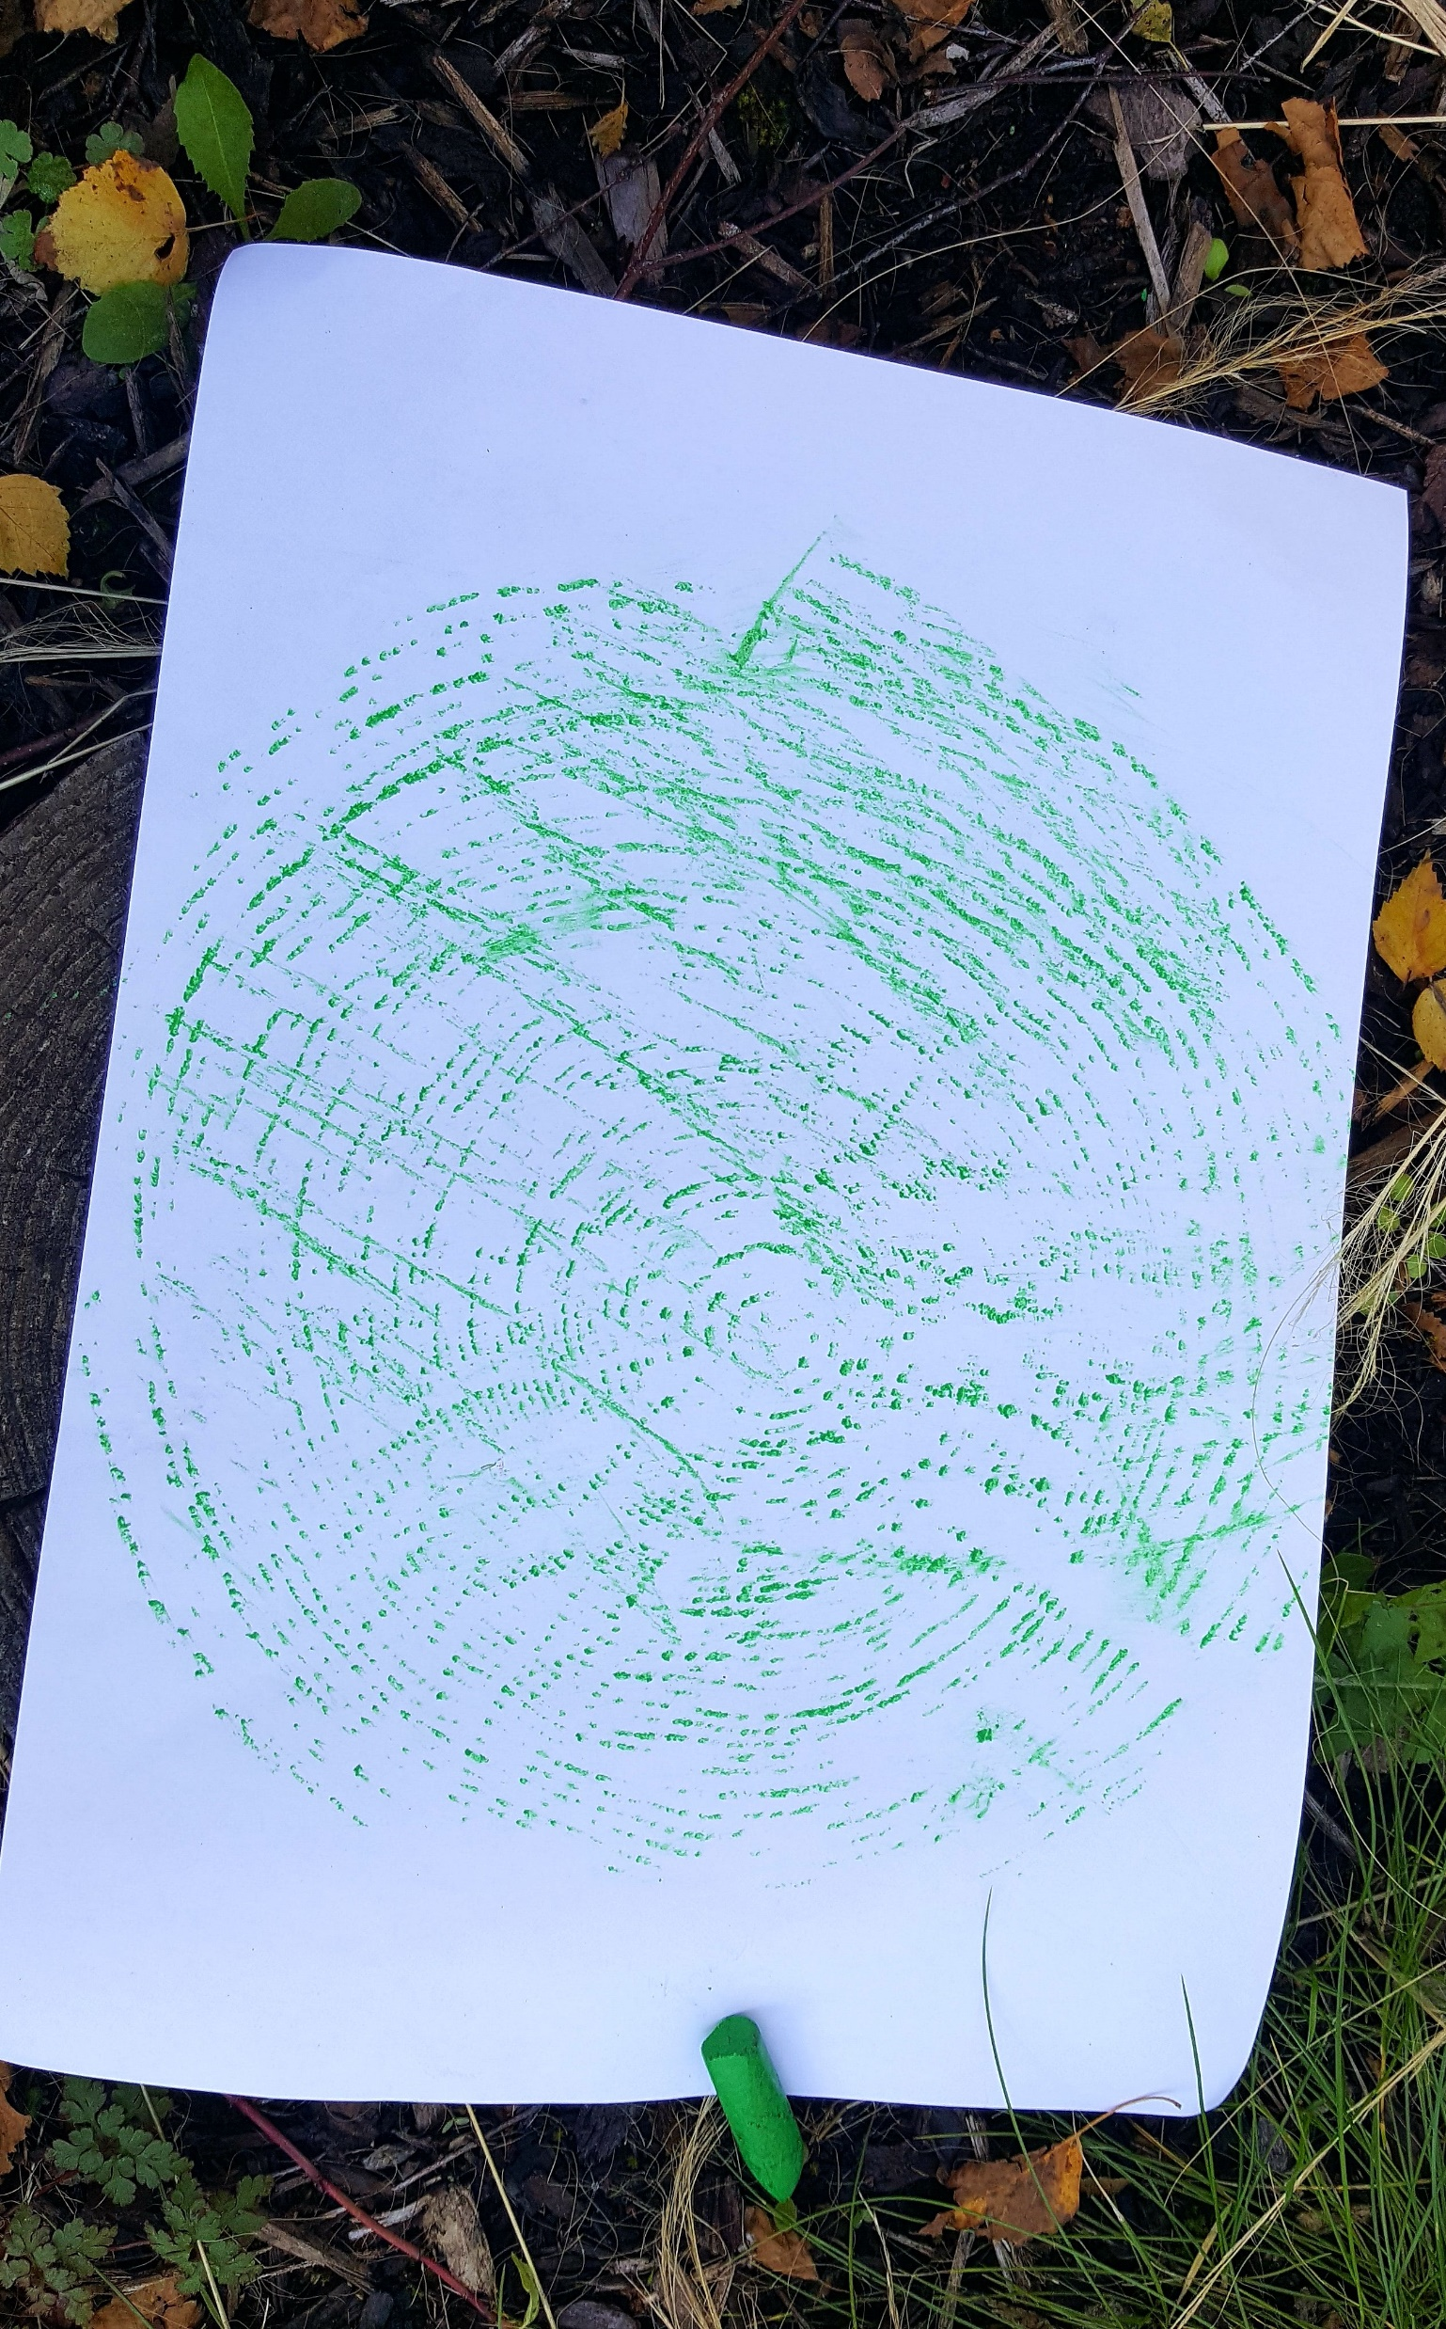
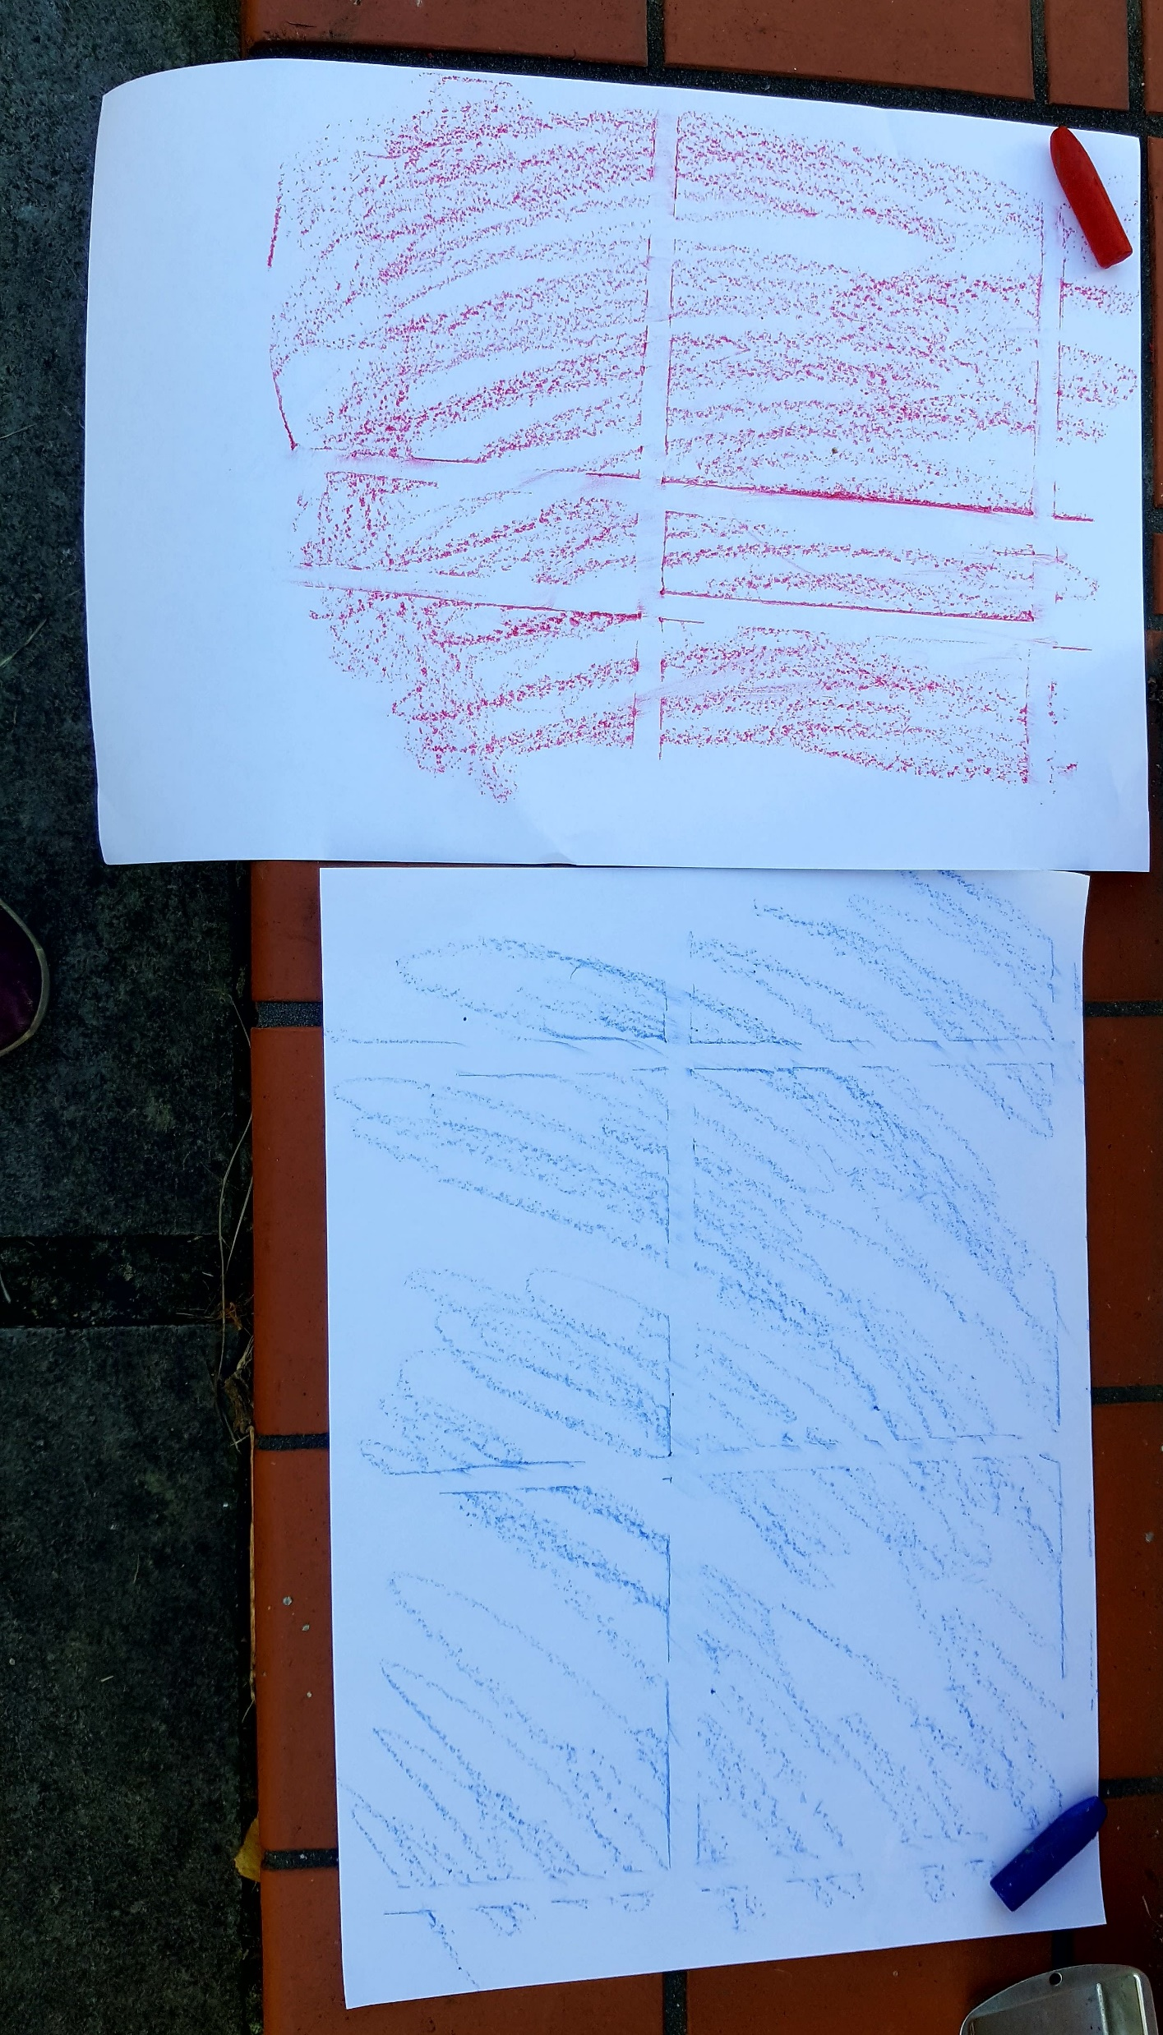
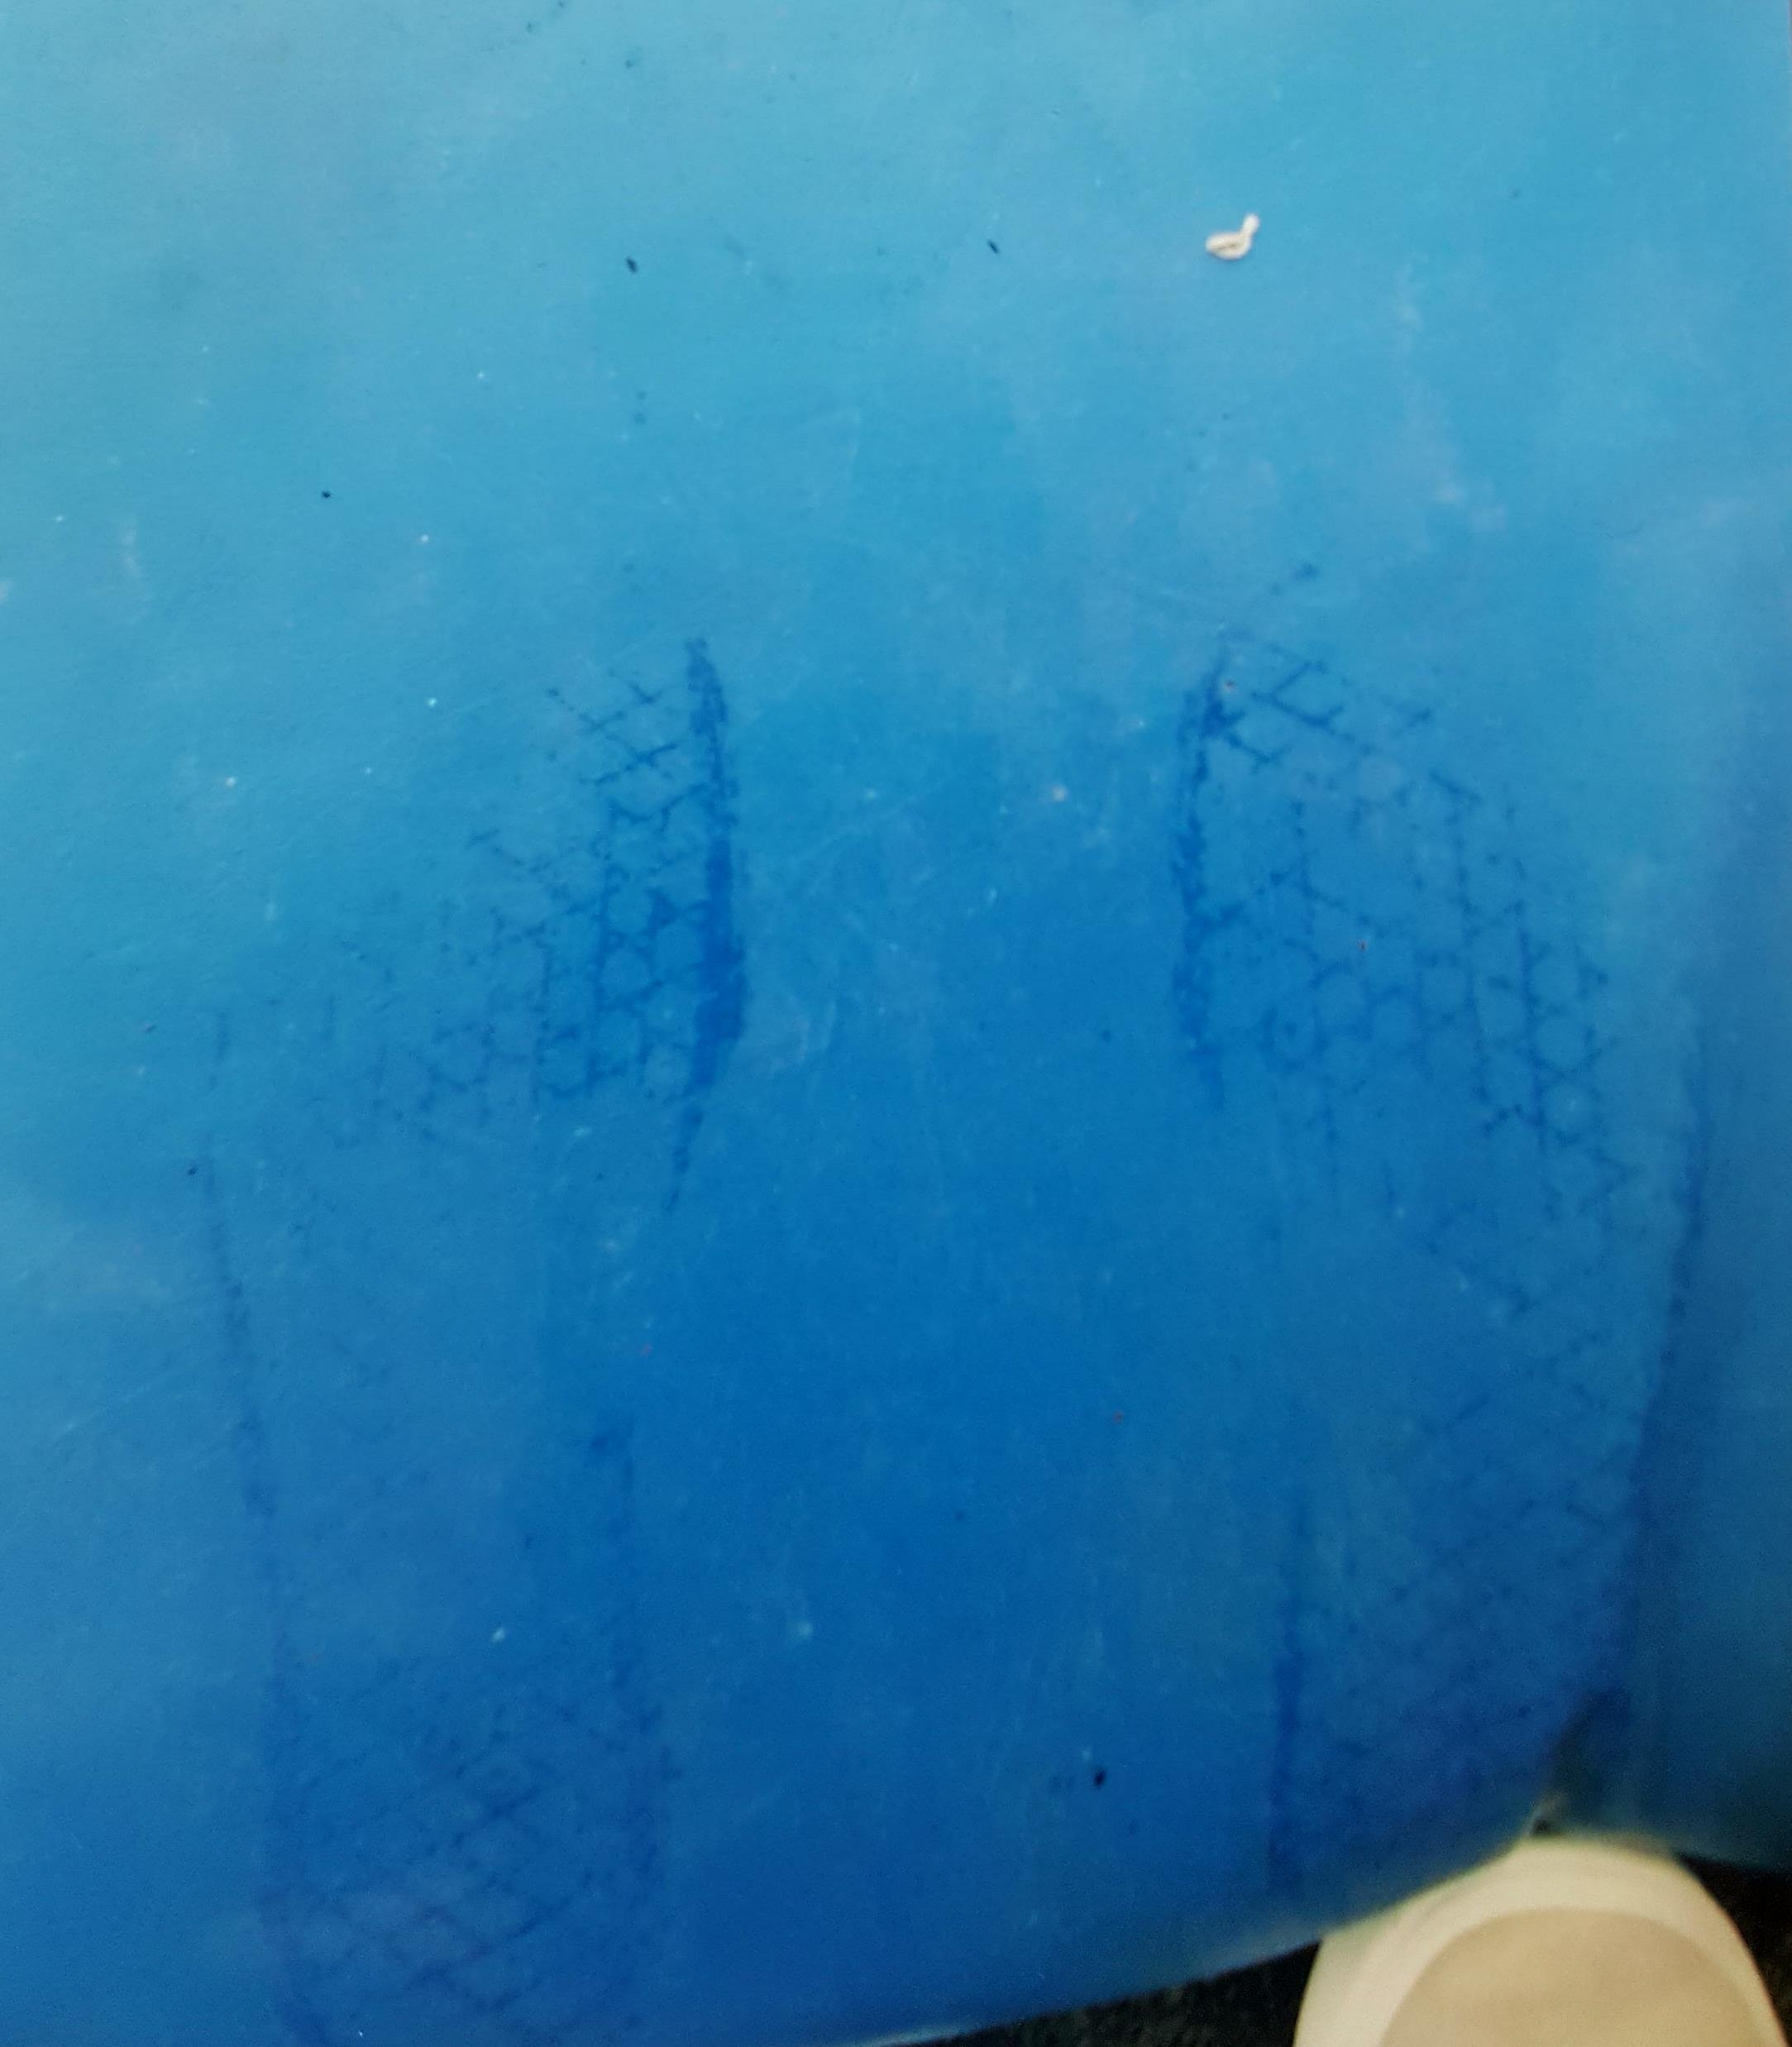
Everyday Learning Experiences that support Early Numeracy
Patterns and sequencing

Slide 5
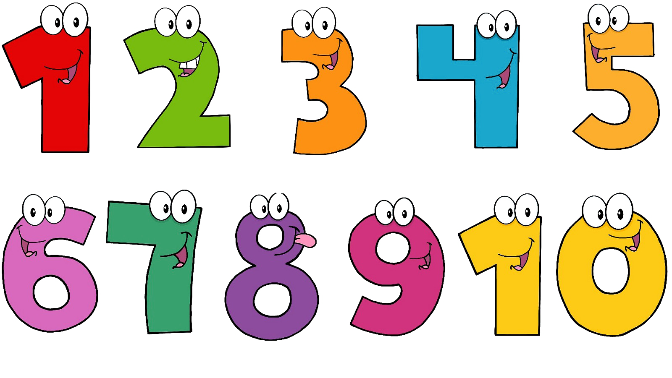
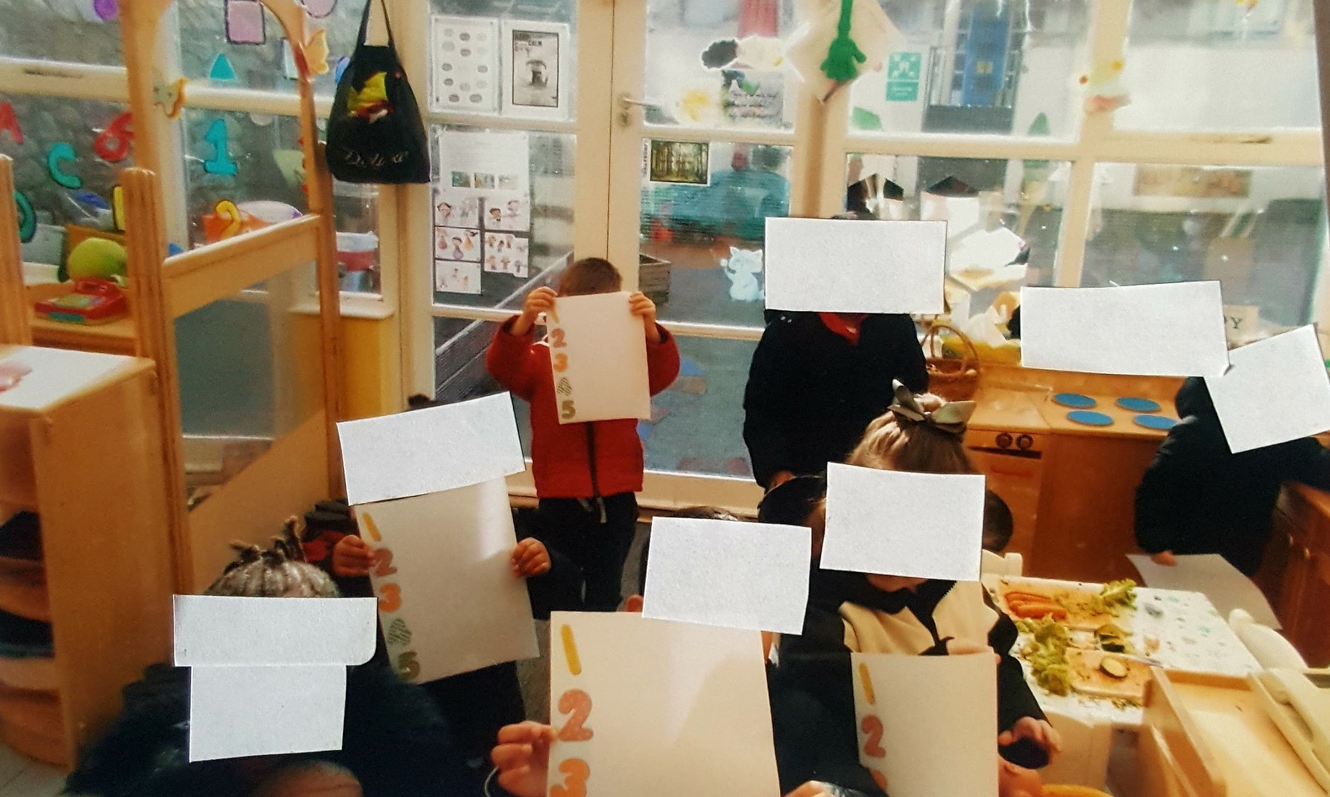
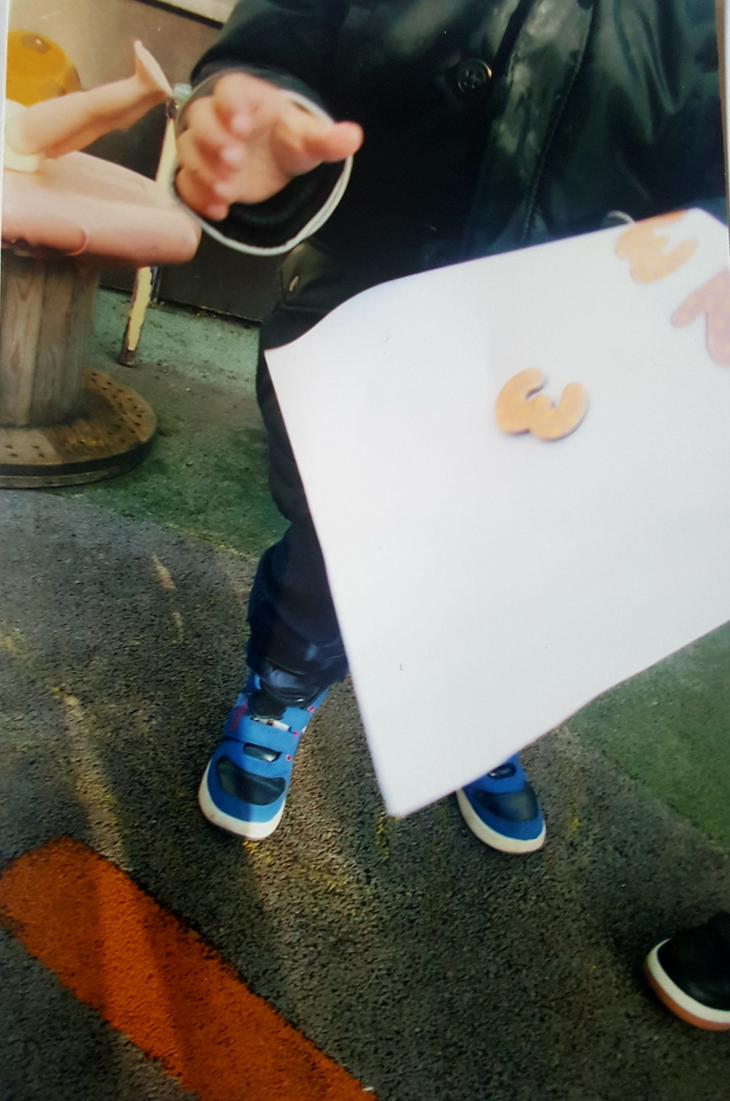
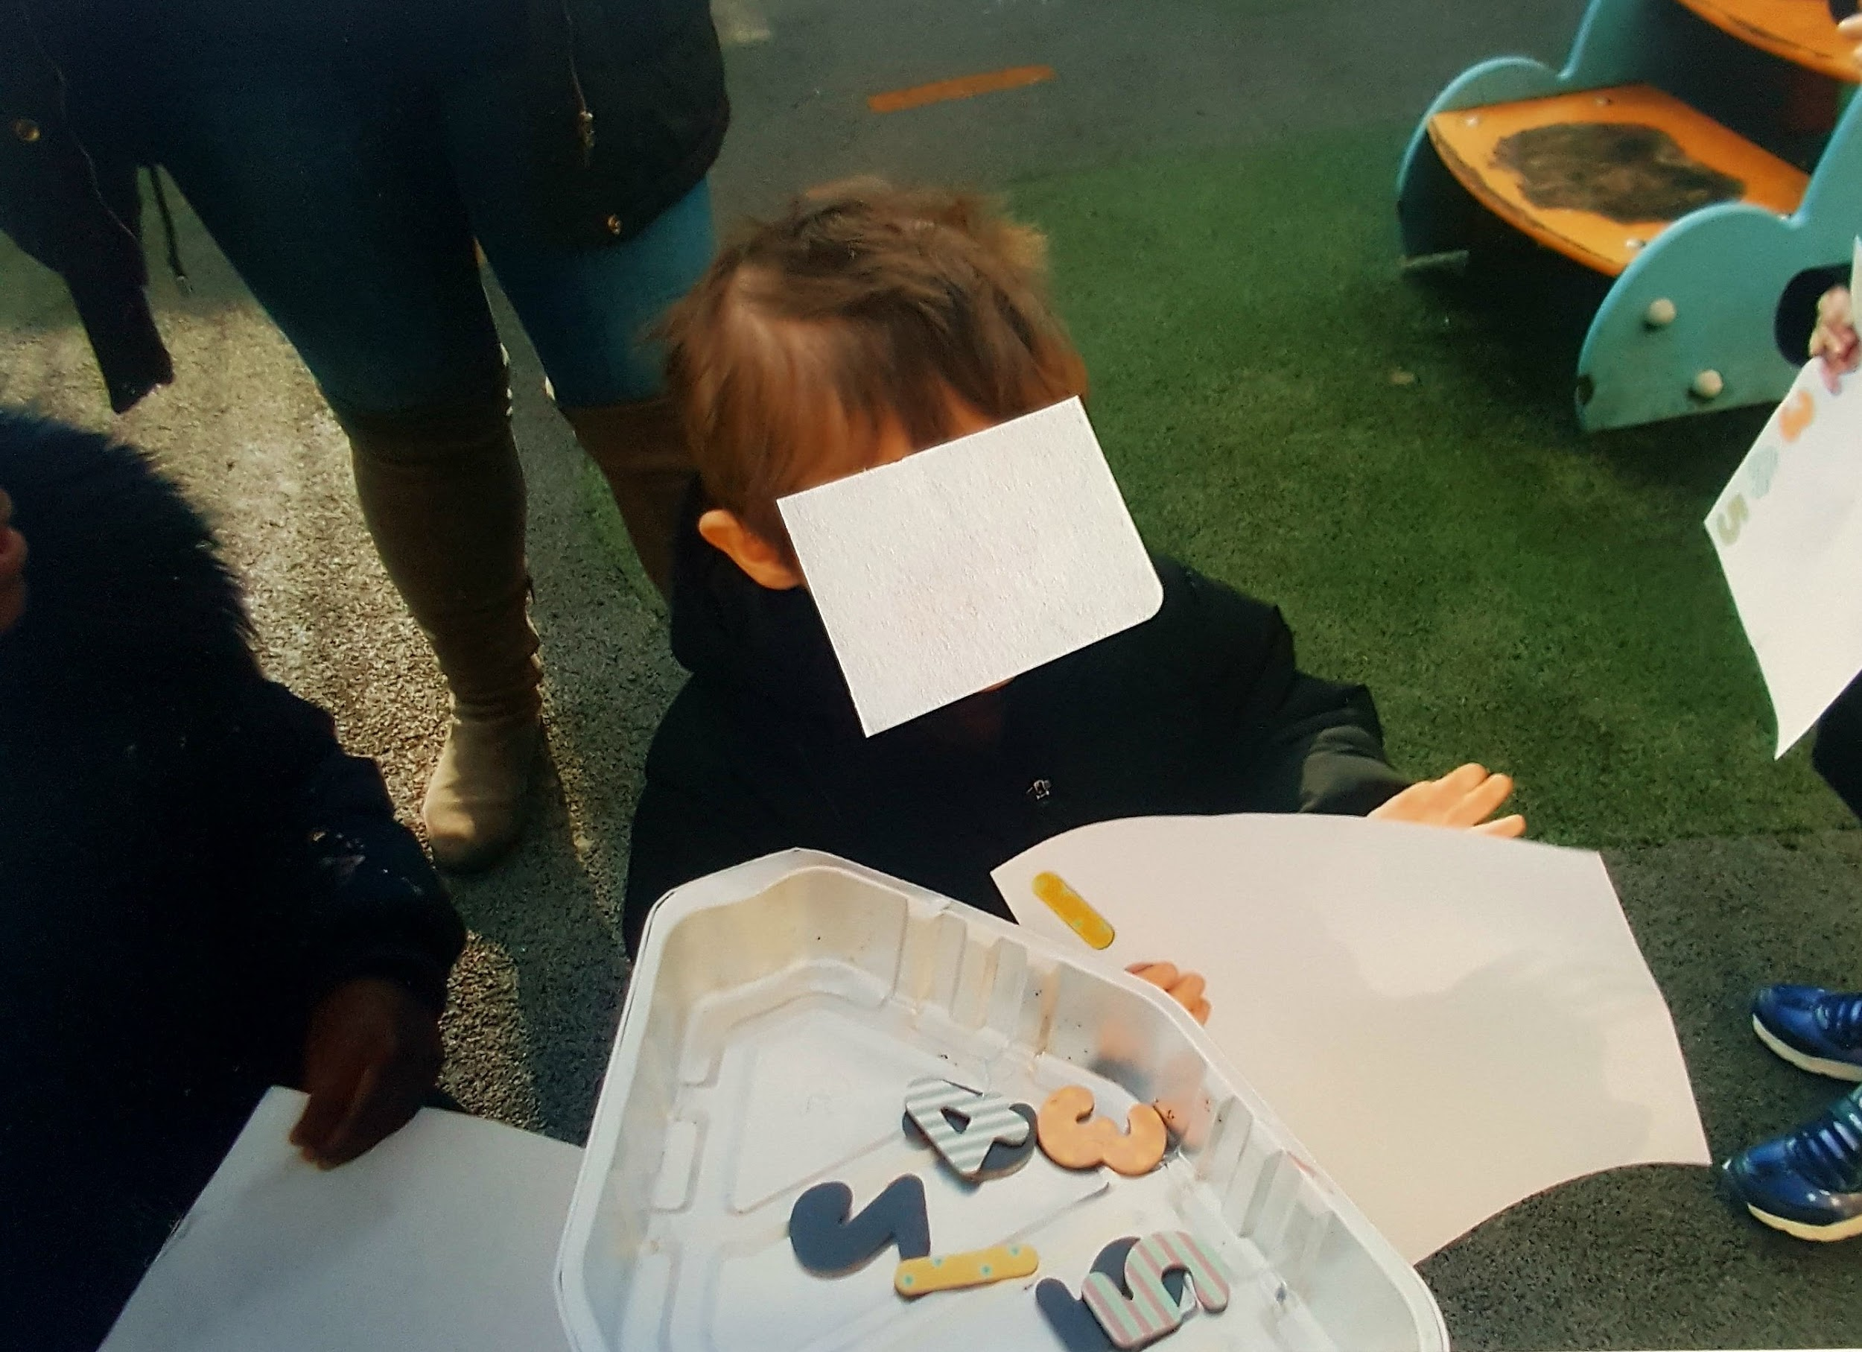
Numbers, counting, etc.

Slide 6
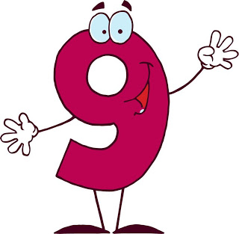
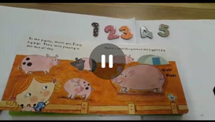
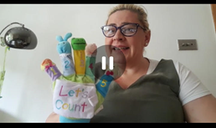
Numbers, counting, etc.

Slide 7

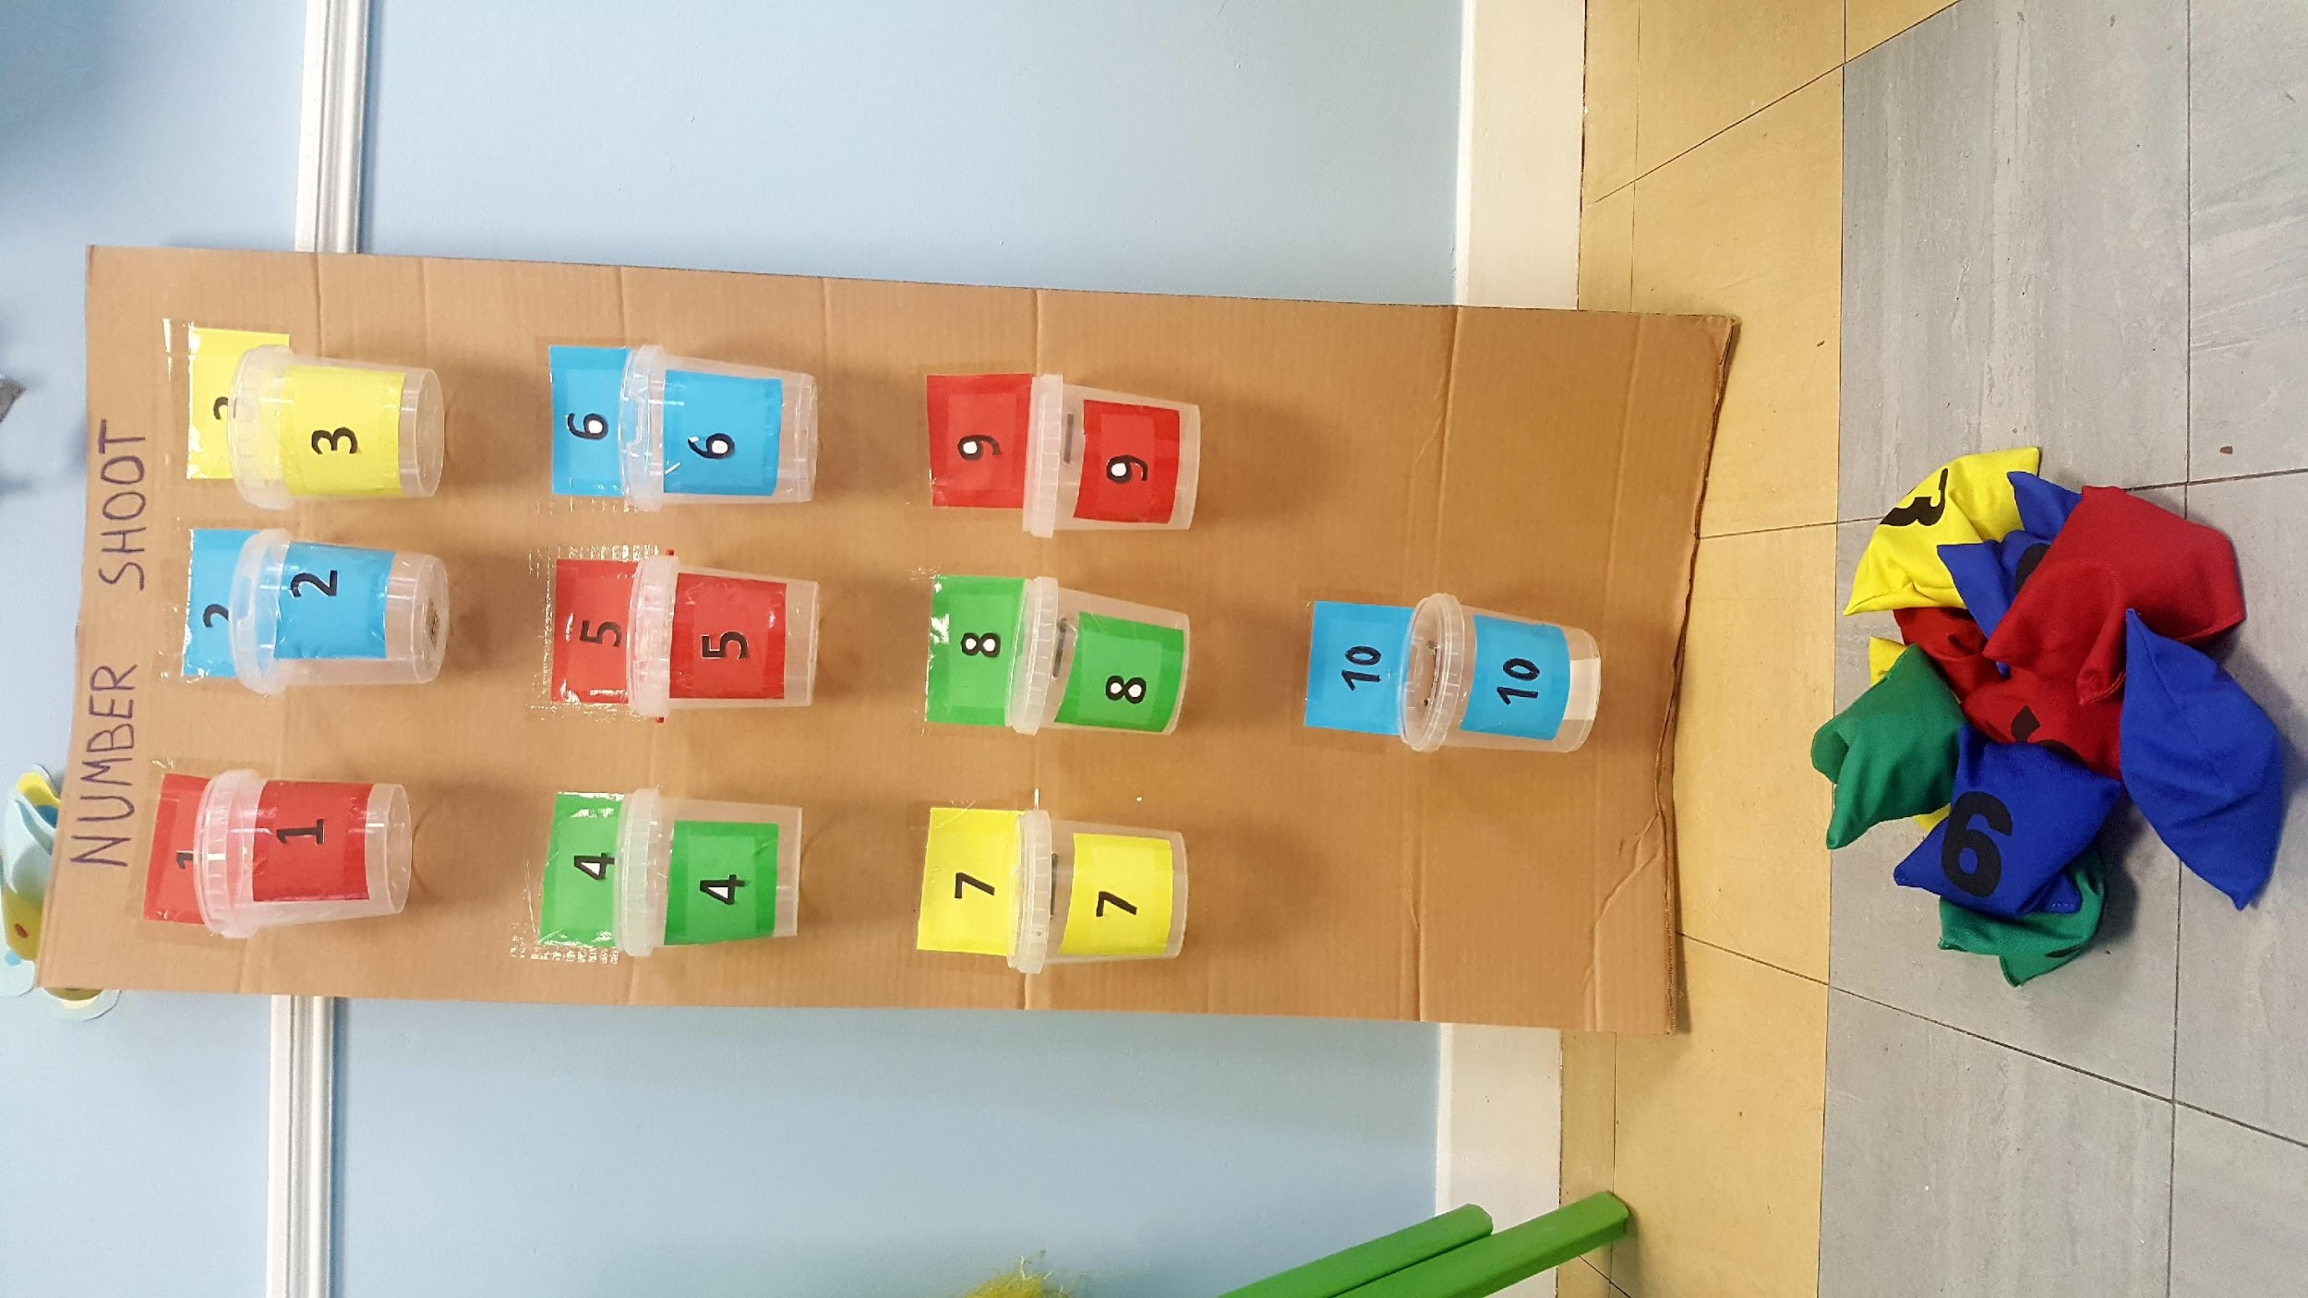
Numbers, counting, etc.

Slide 8

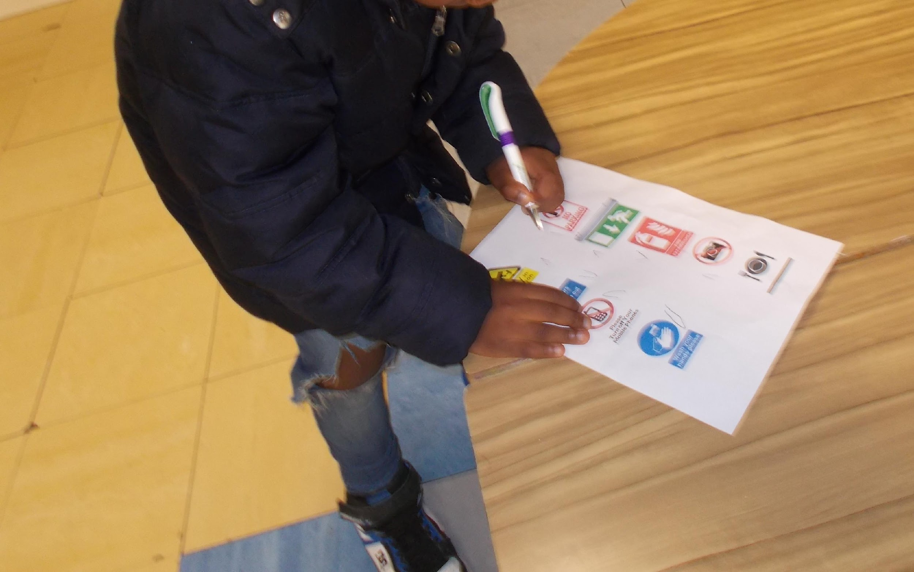
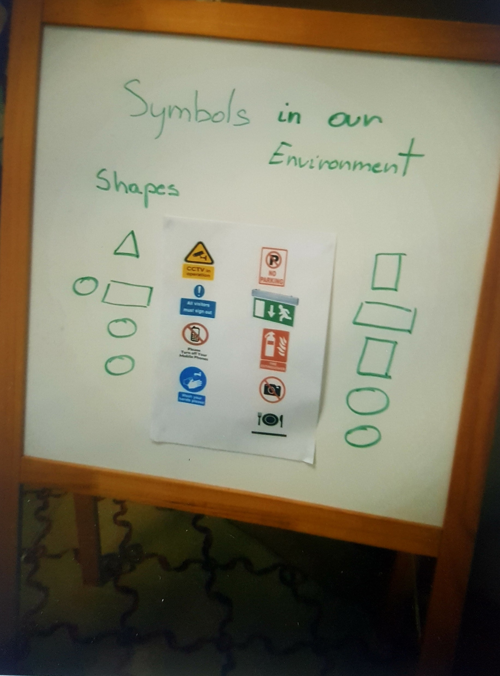
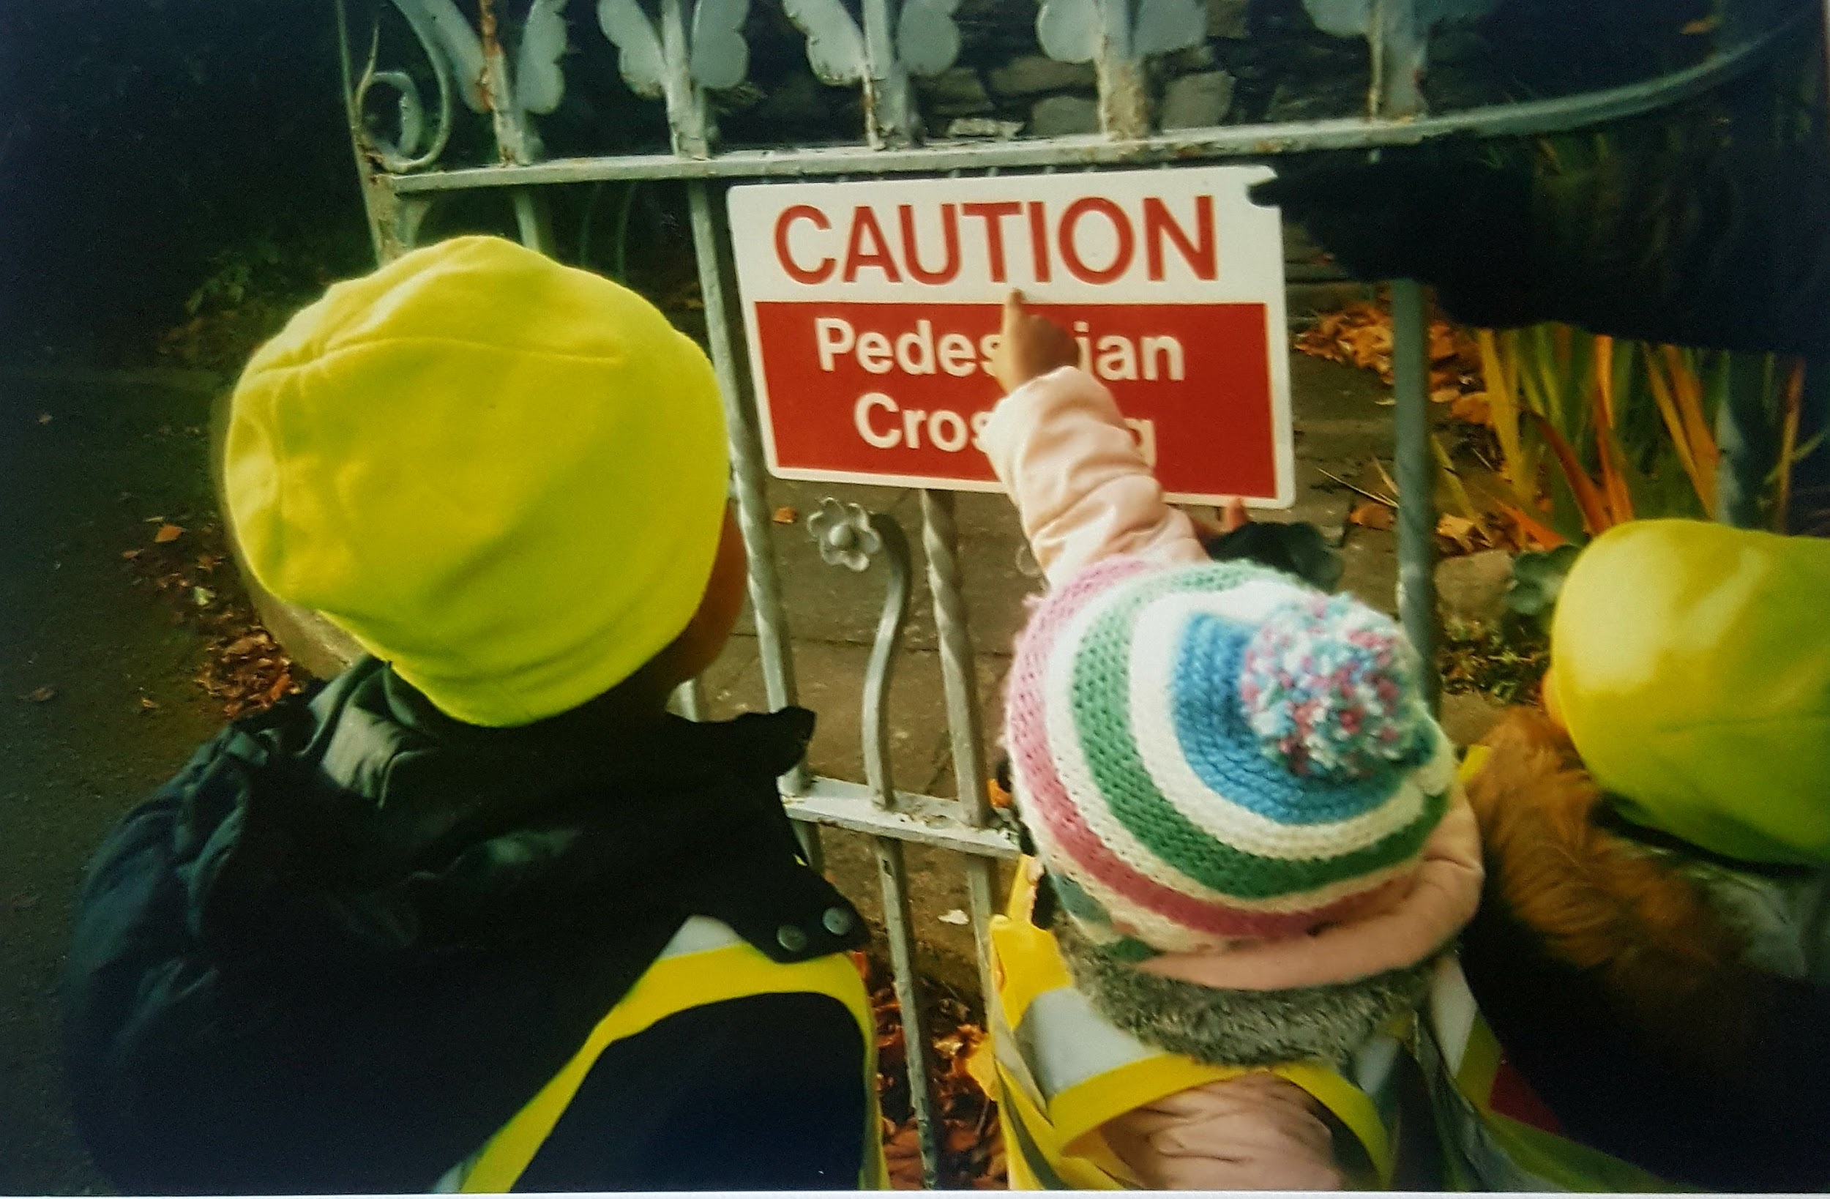
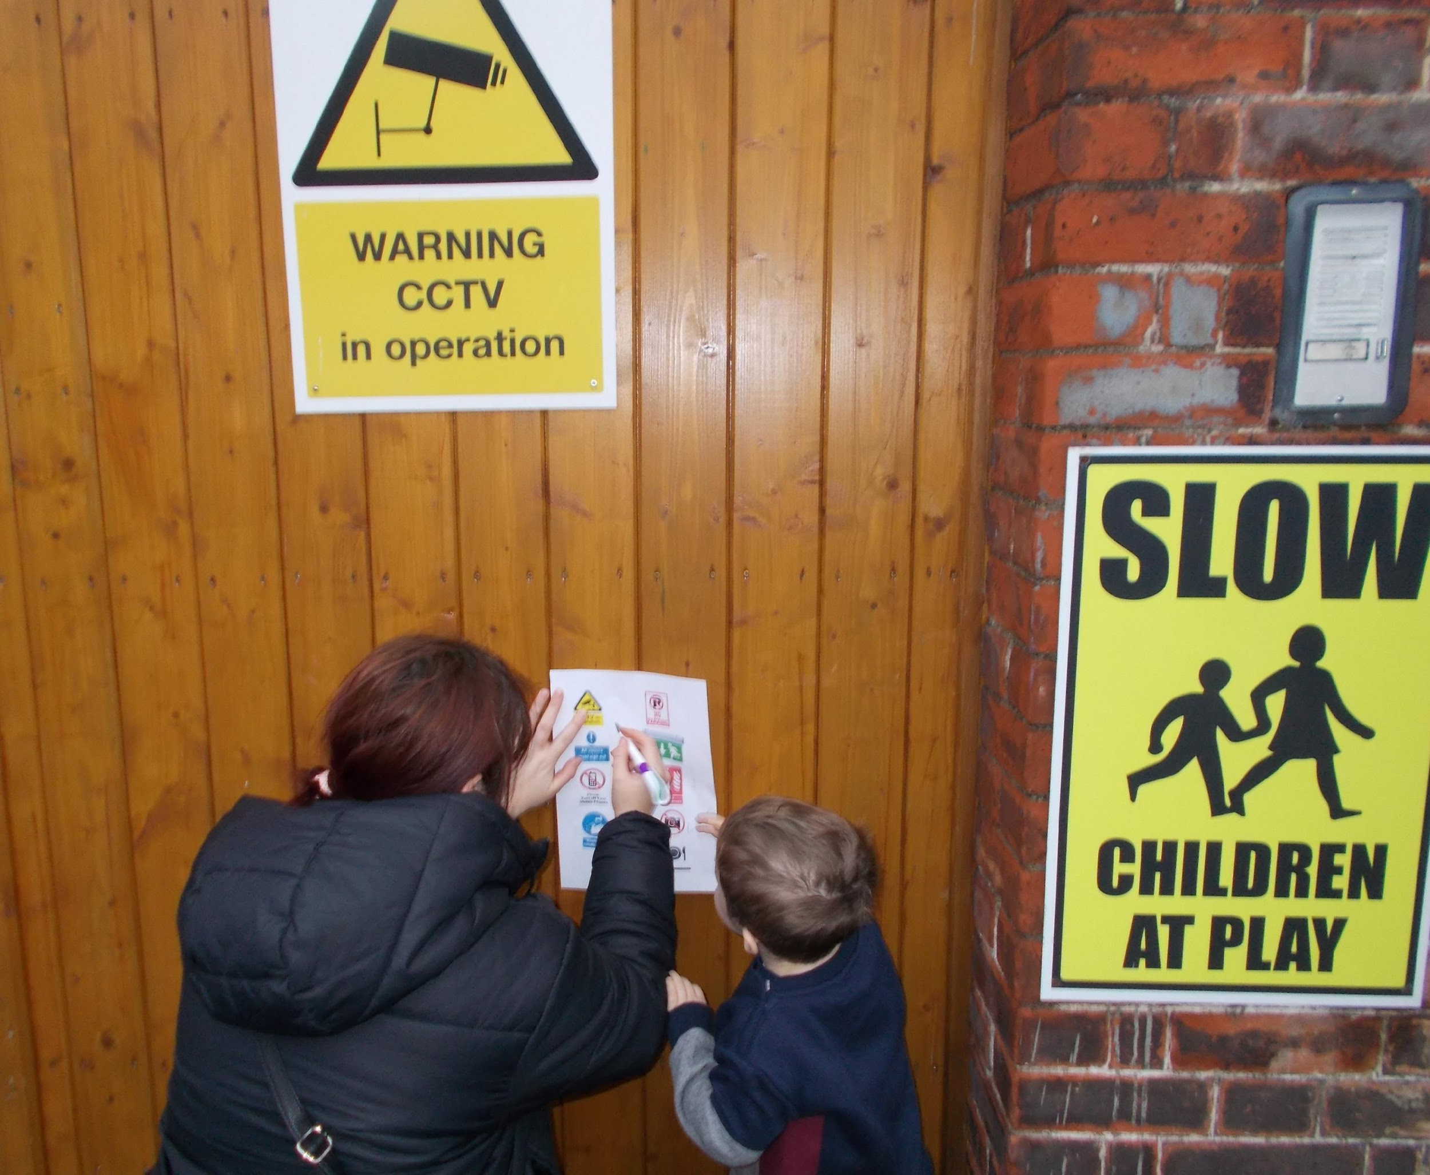
Symbols, signs, shapes, pictures, image, letters, etc.

Slide 9
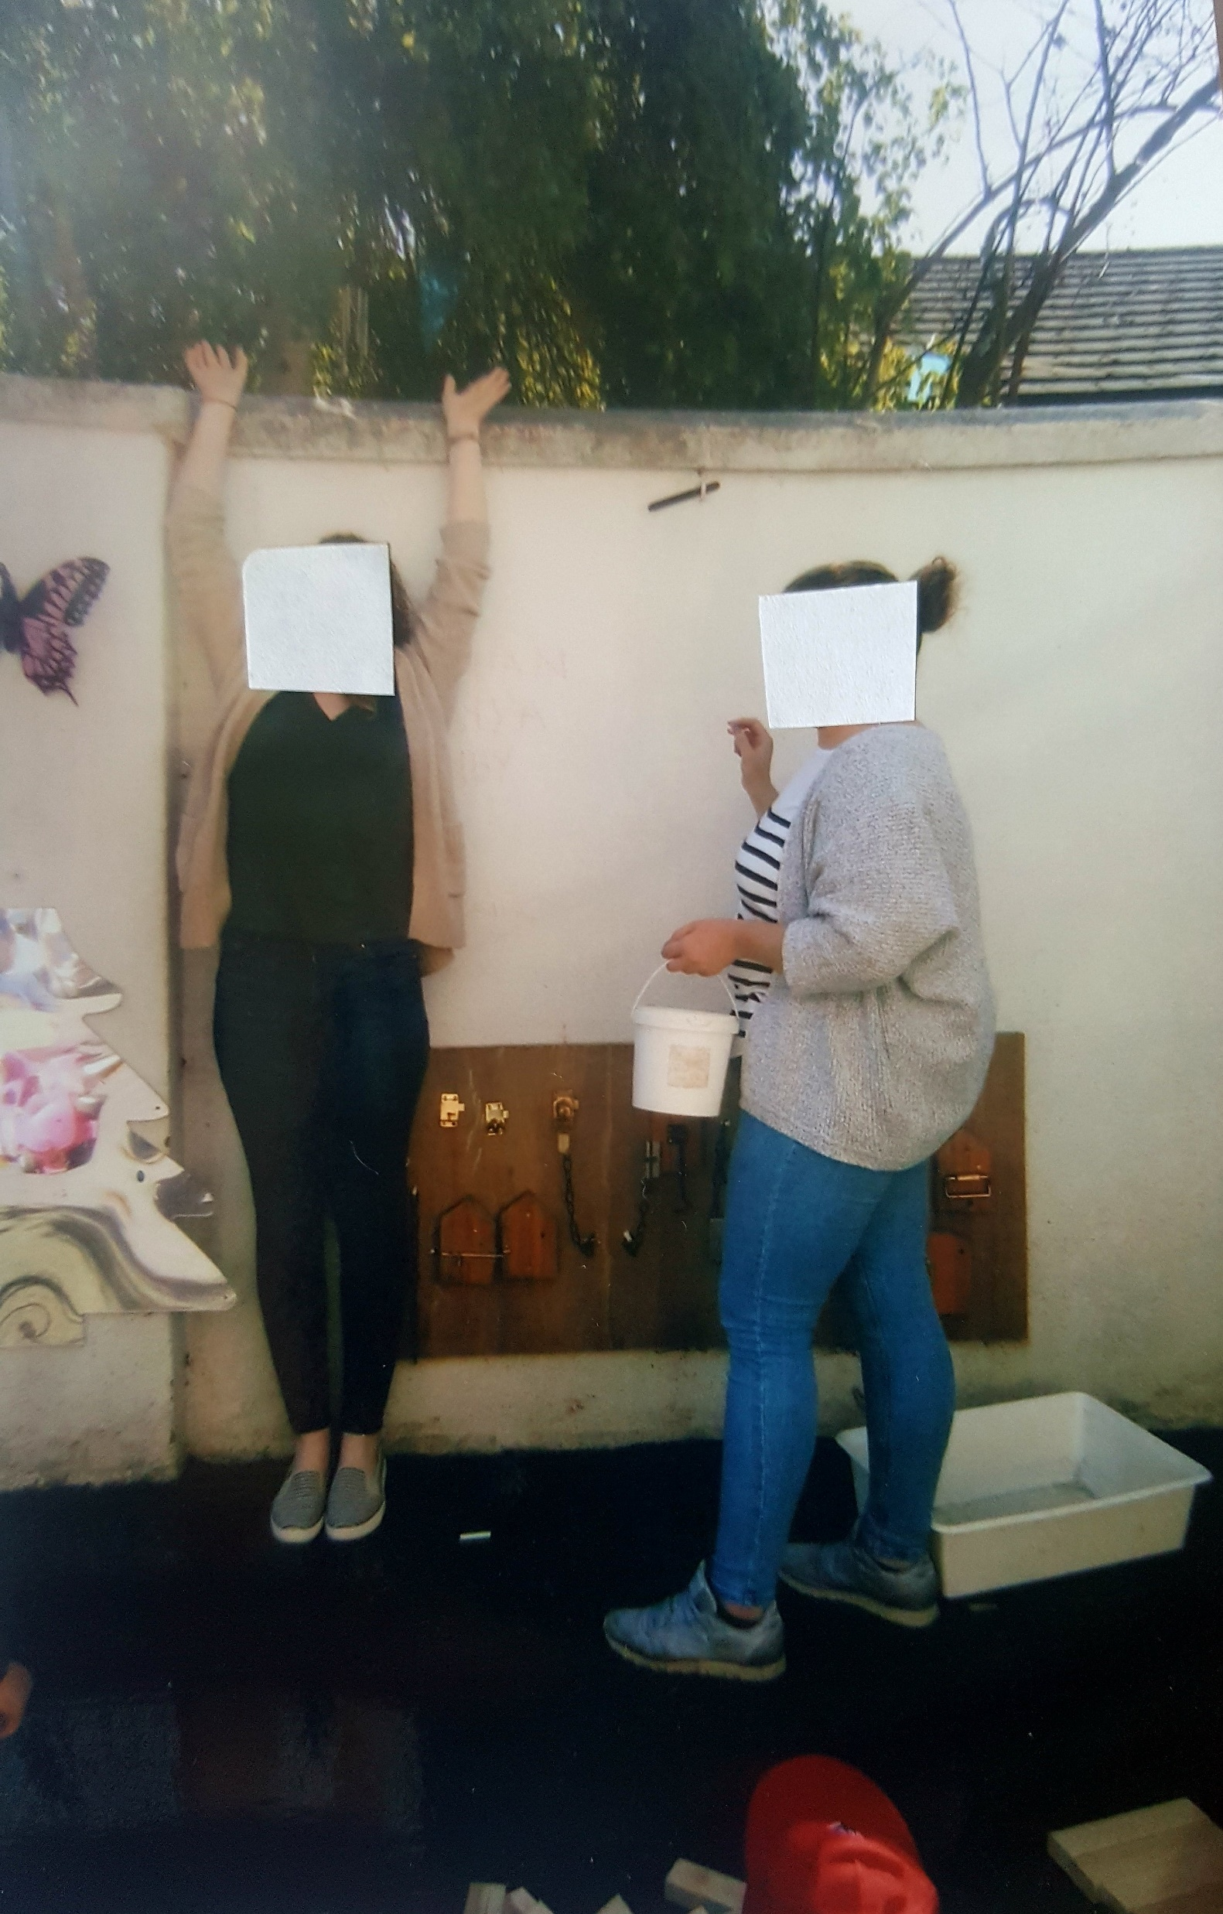
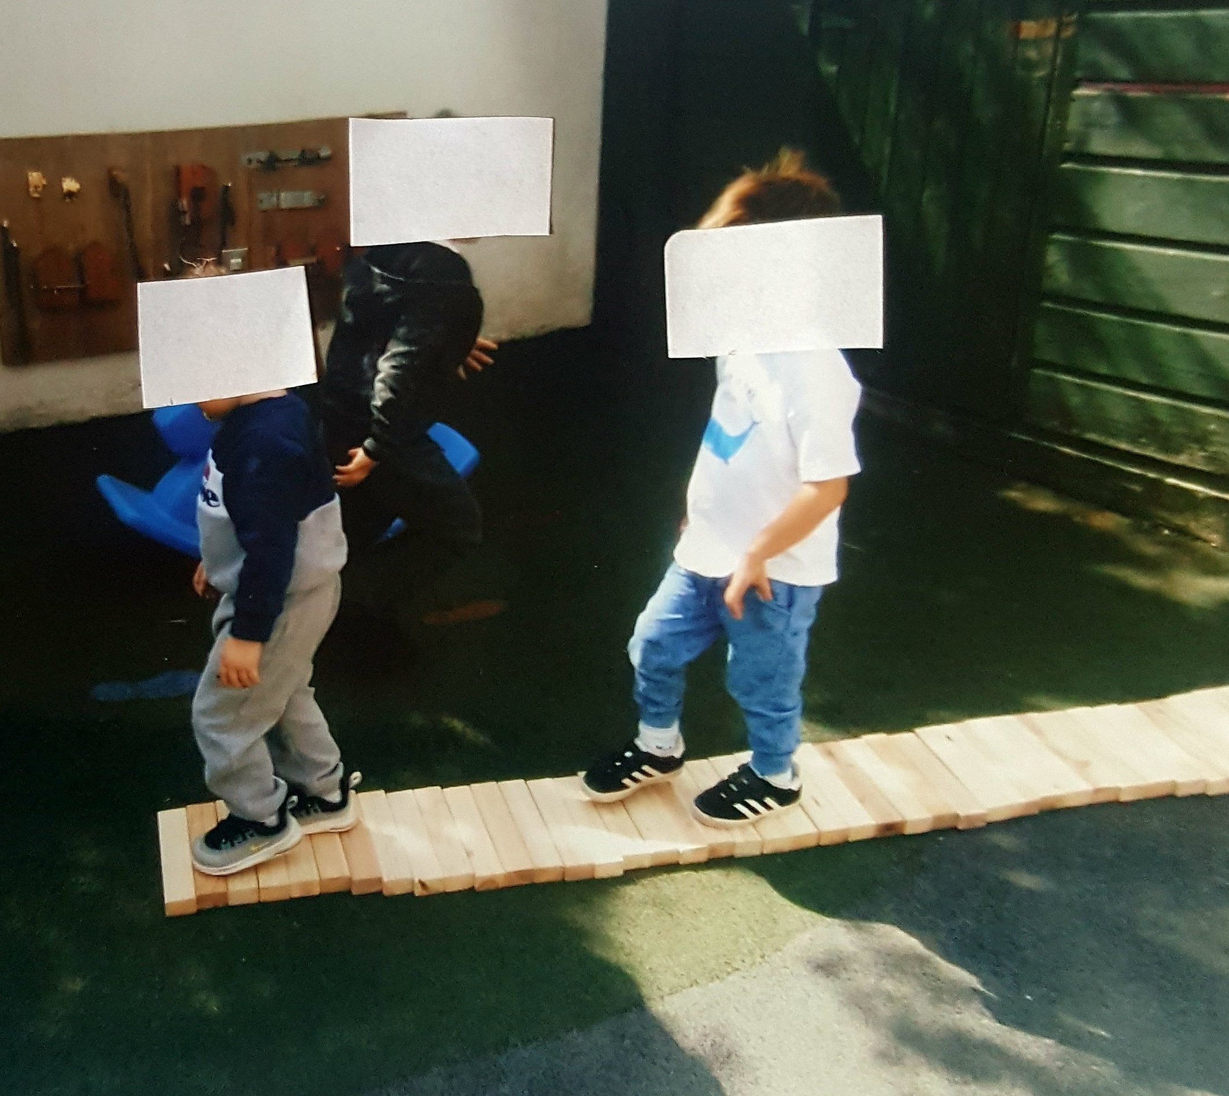
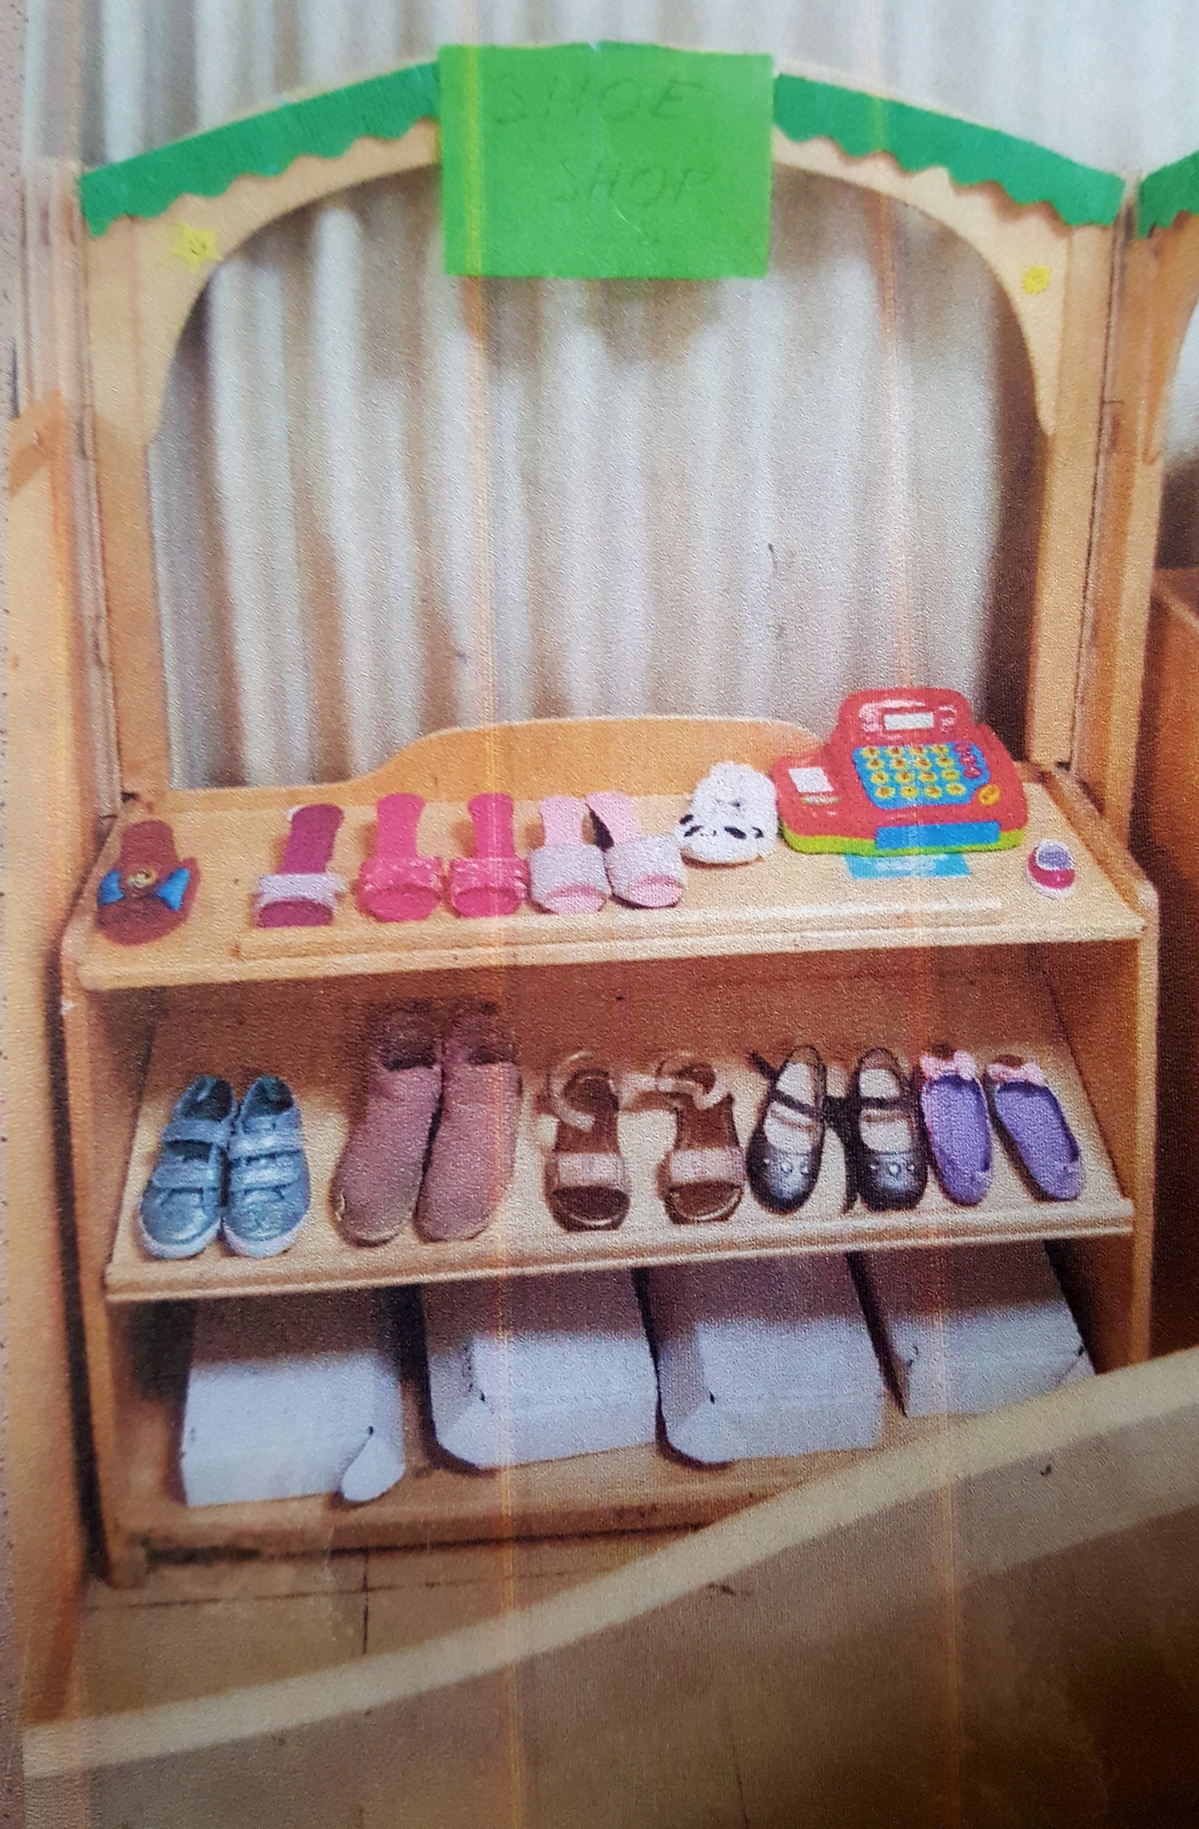
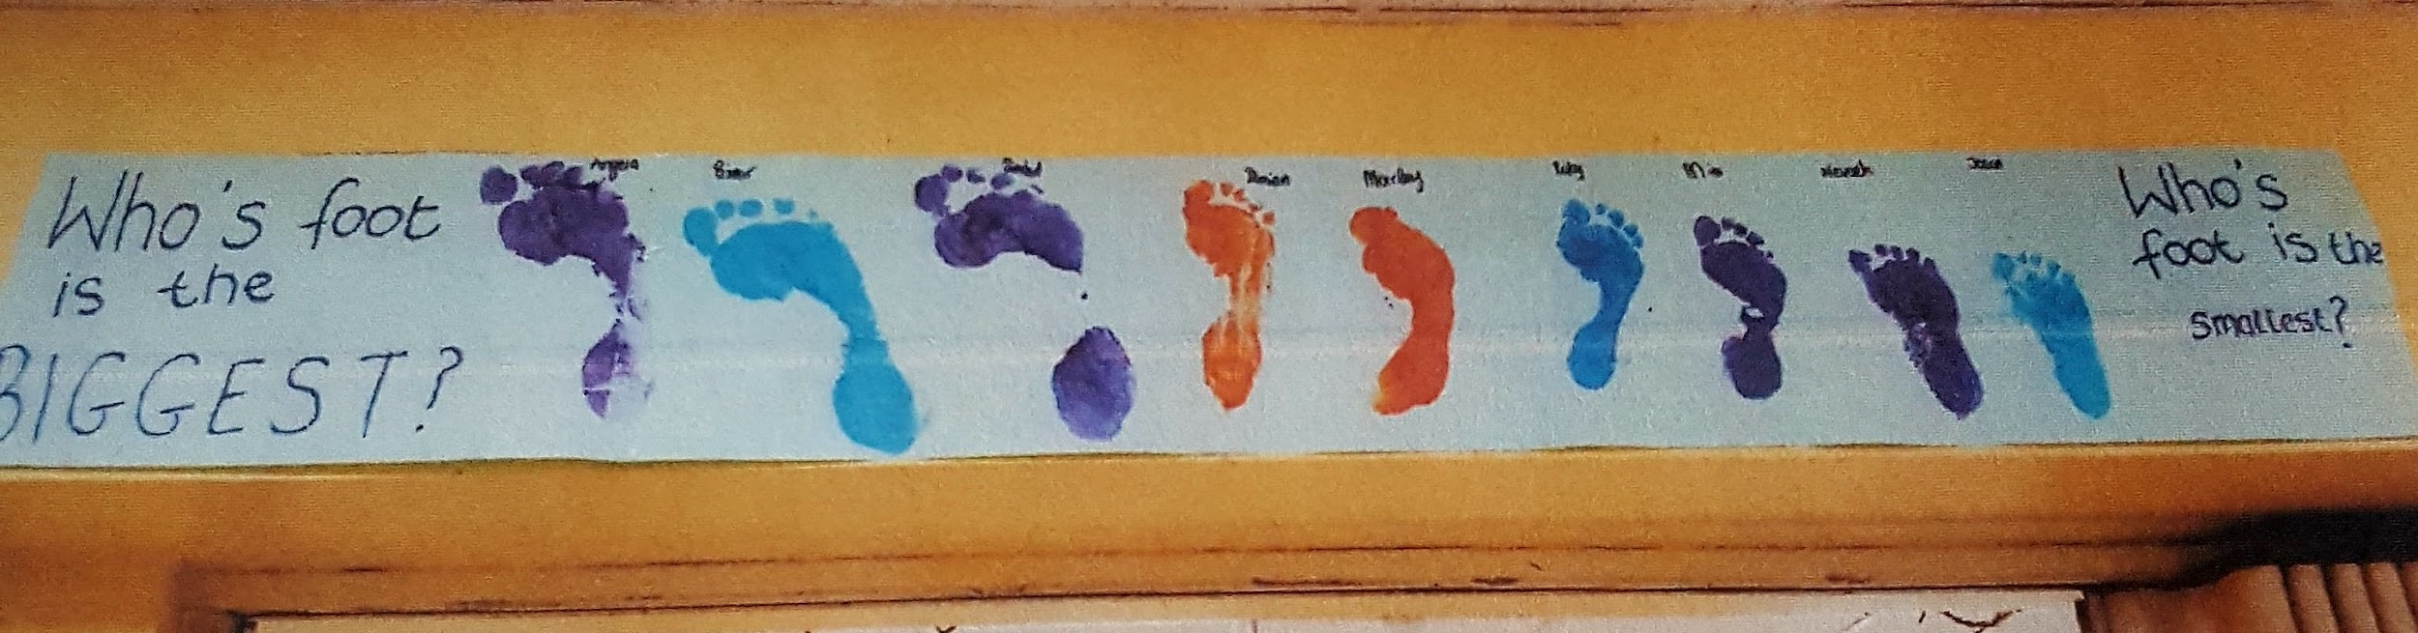
Measurement, size, length, etc.

Slide 10
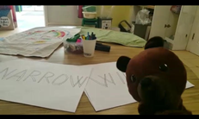
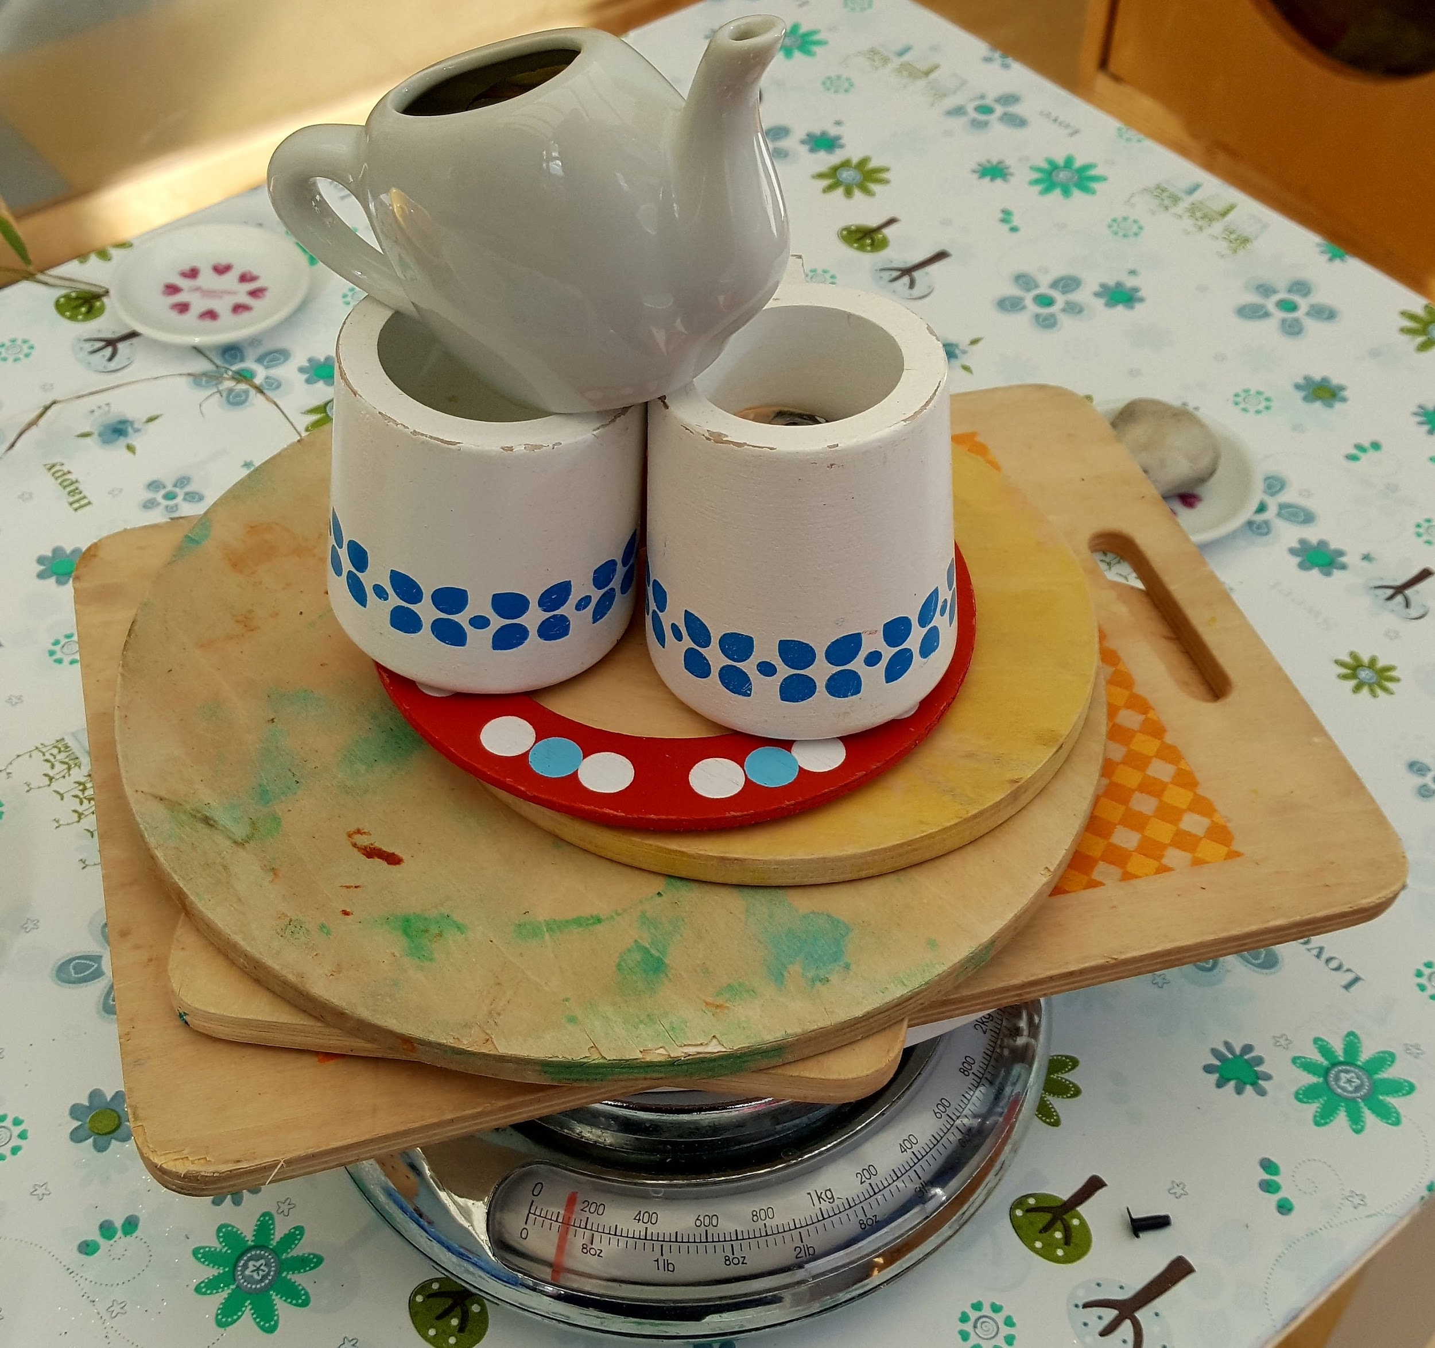
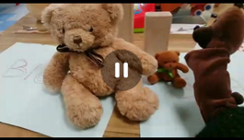
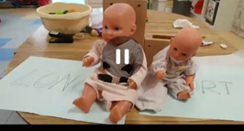
Measurement, size, lengths, etc.

Slide 11


